Slide 1
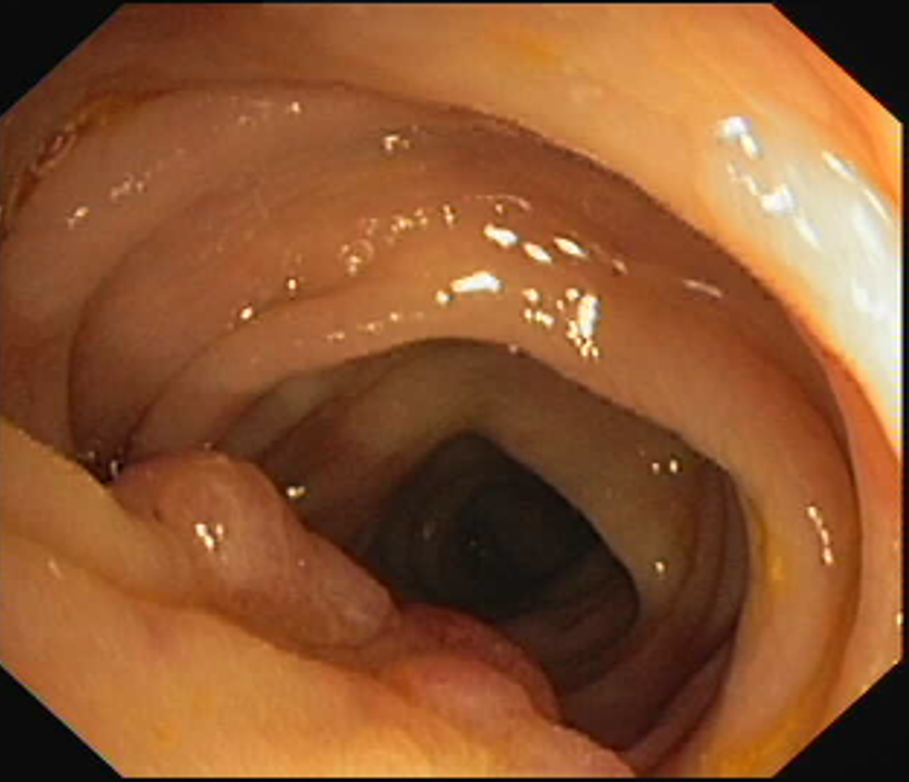
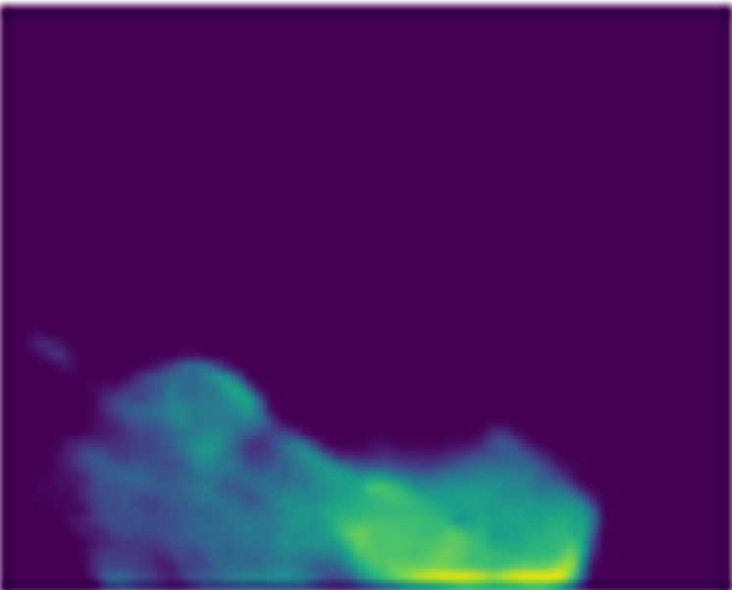
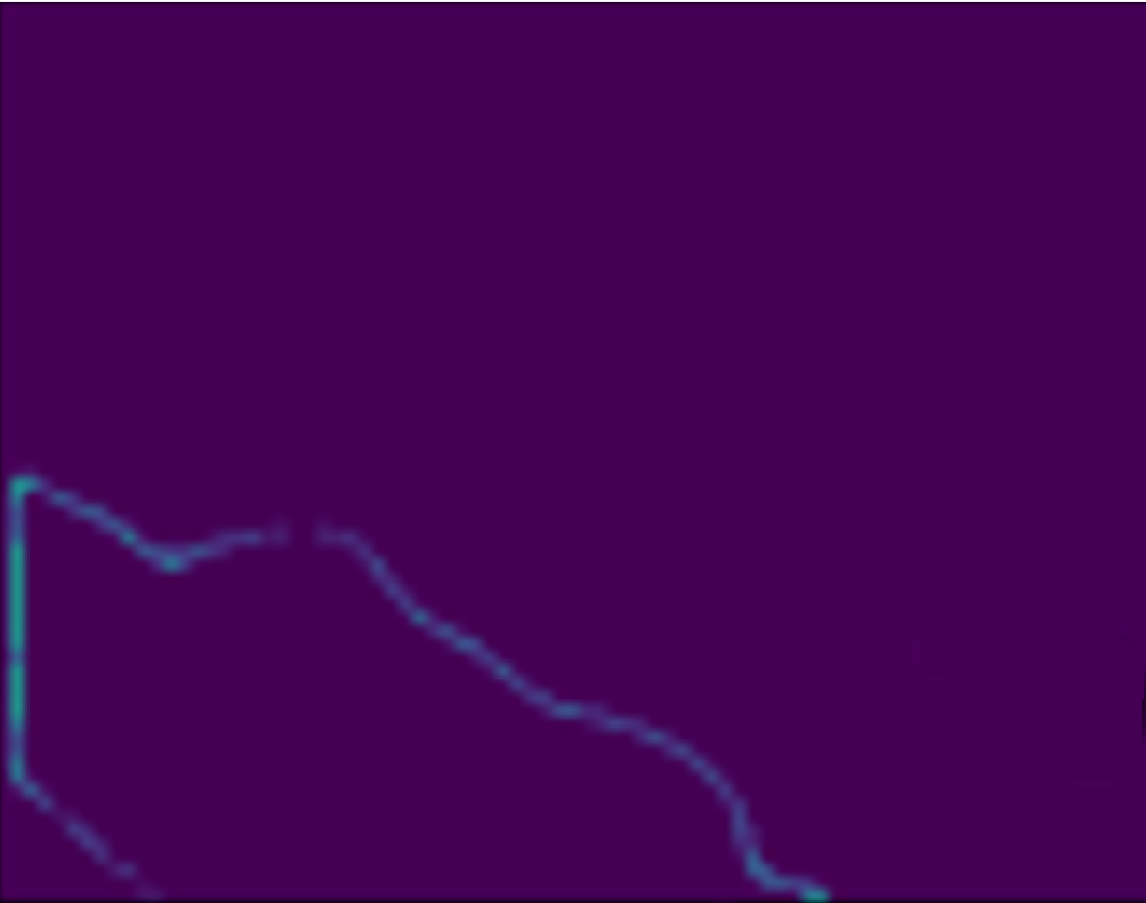
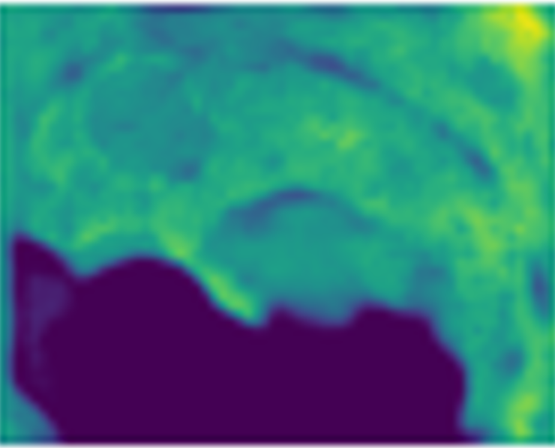
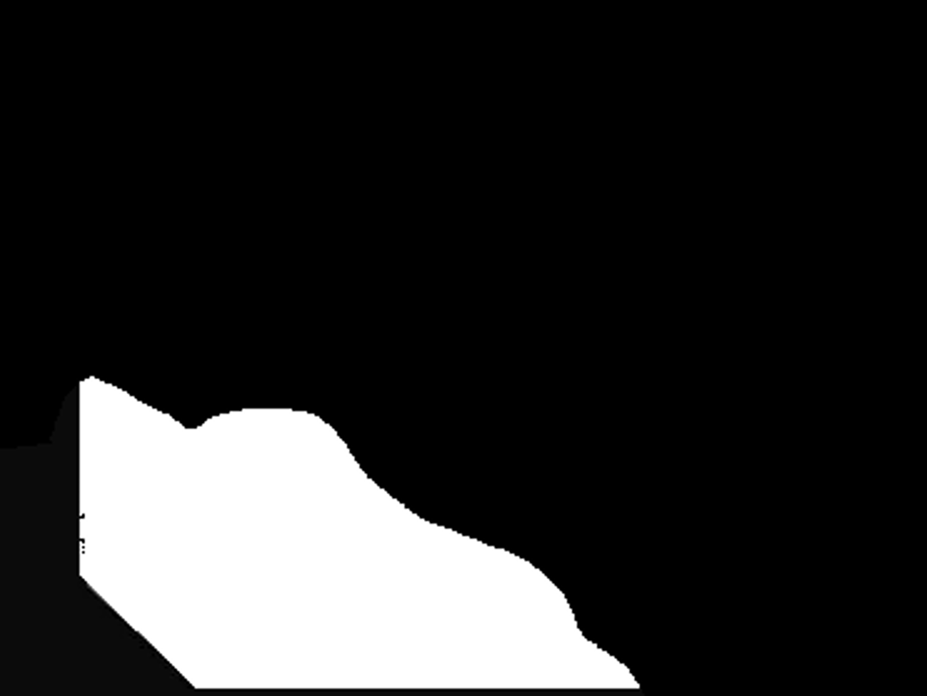























MSCB
UAB:Uncertainty Attention Block
3x3 Micro Step Conv
Maxpool
Batch Norm
Q
Q Conv
DC1
Image
K
3x3 Dilated Conv dilation=2
Batch Norm
K Conv
MLP
DC2
Maxpool
1x1 Conv
V
feature
3x3 Dilated Conv dilation=3
Batch Norm
Uncertainty Map
V Conv
Softmax
Uncertainty Map
$$1×H×W$$
MDB:Micro Step& Dilated Conv Block
$$D\left(p | α\right)=\left\{\begin{aligned}\frac{1}{B\left(α,β\right)}p_{0}^{α−1}p_{1}^{β−1} \\ 0 else\end{aligned}\right.$$
$$C_{1}×\frac{H}{2}×\frac{W}{2}$$
$$C_{1}×\frac{H}{2}×\frac{W}{2}$$
$$u=\frac{K}{S}$$
$$3×H×W$$
2$×H×W$
UAB
Input
$$C_{2}×\frac{H}{4}×\frac{W}{4}$$
$$C_{2}×\frac{H}{4}×\frac{W}{4}$$
Evidence
$$2×H×W$$
Segmentation results
$$1×H×W$$
1x1 Conv
$$C_{1}×\frac{H}{2}×\frac{W}{2}$$
$$C_{1}×\frac{H}{2}×\frac{W}{2}$$
Maxpool
$$C_{3}×\frac{H}{8}×\frac{W}{8}$$
MSCB
MSCB
DC1
DC1
$$C_{2}×\frac{H}{4}×\frac{W}{4}$$
$$C_{3}×\frac{H}{8}×\frac{W}{8}$$
Evidence head
MSCB
DC2
Skip connection
$$D_{1}×\frac{H}{16}×\frac{W}{16}$$
$$D_{1}×\frac{H}{16}×\frac{W}{16}$$
$3×3$Conv
$$×α$$
$$×(1−α)$$
$$C_{3}×\frac{H}{8}×\frac{W}{8}$$
KAB
KAB
Micro Step& Dilated Conv Block
Addition
Output
$$D_{2}×\frac{H}{32}×\frac{W}{32}$$
KAB
KAB
$$D_{2}×\frac{H}{32}×\frac{W}{32}$$
Up sampling

Slide 2
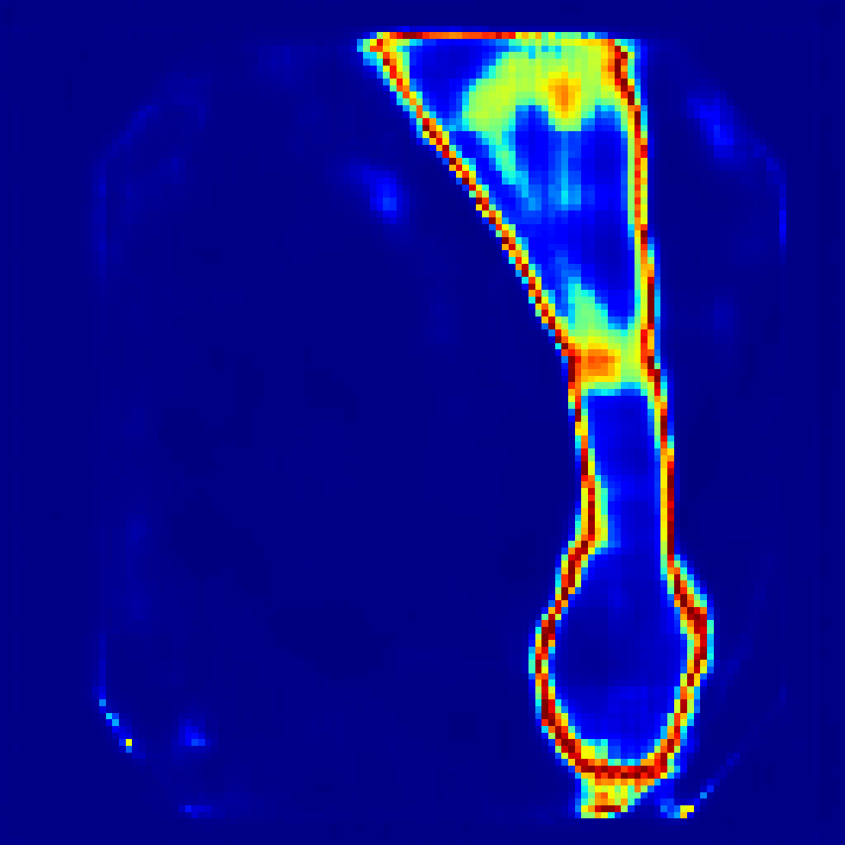
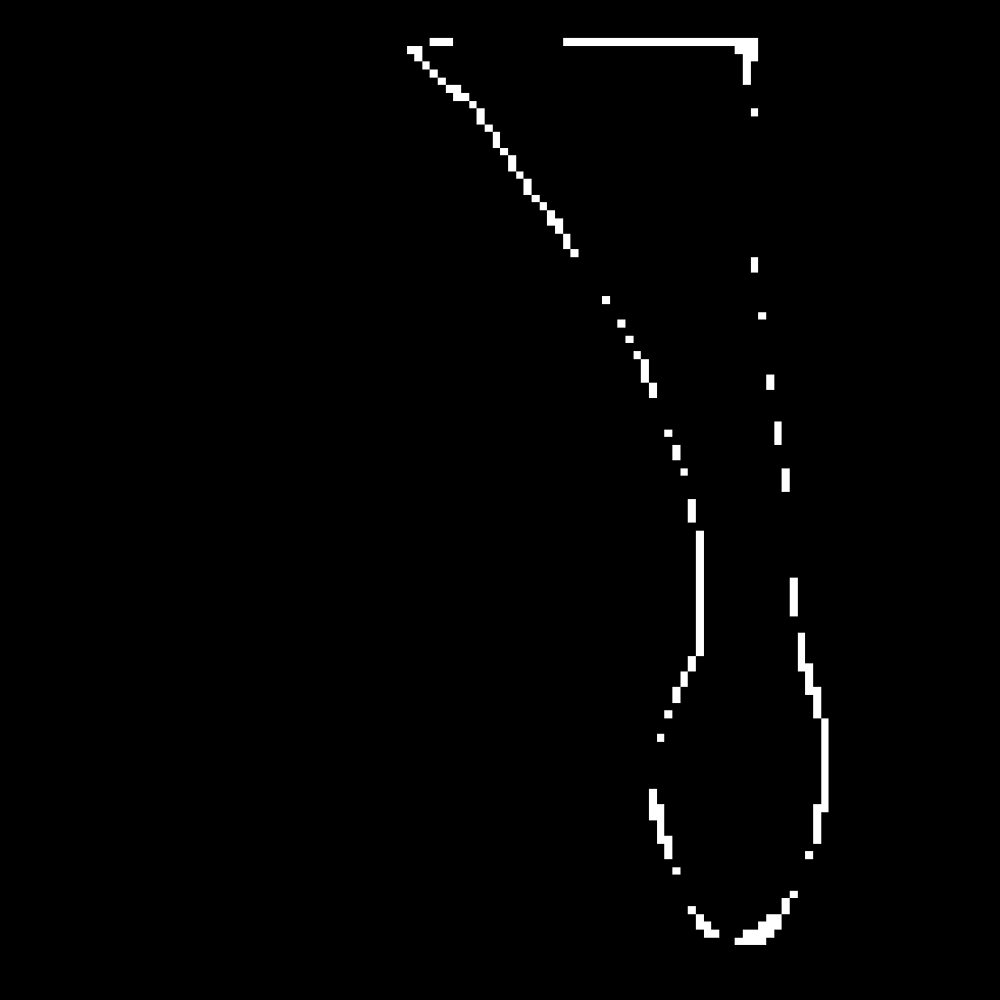
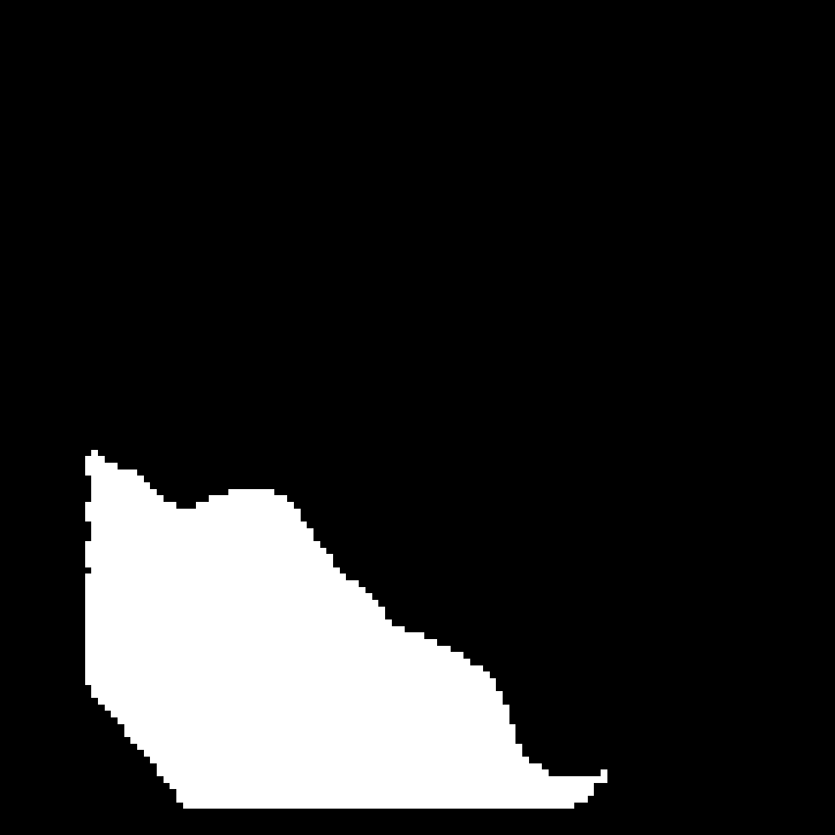
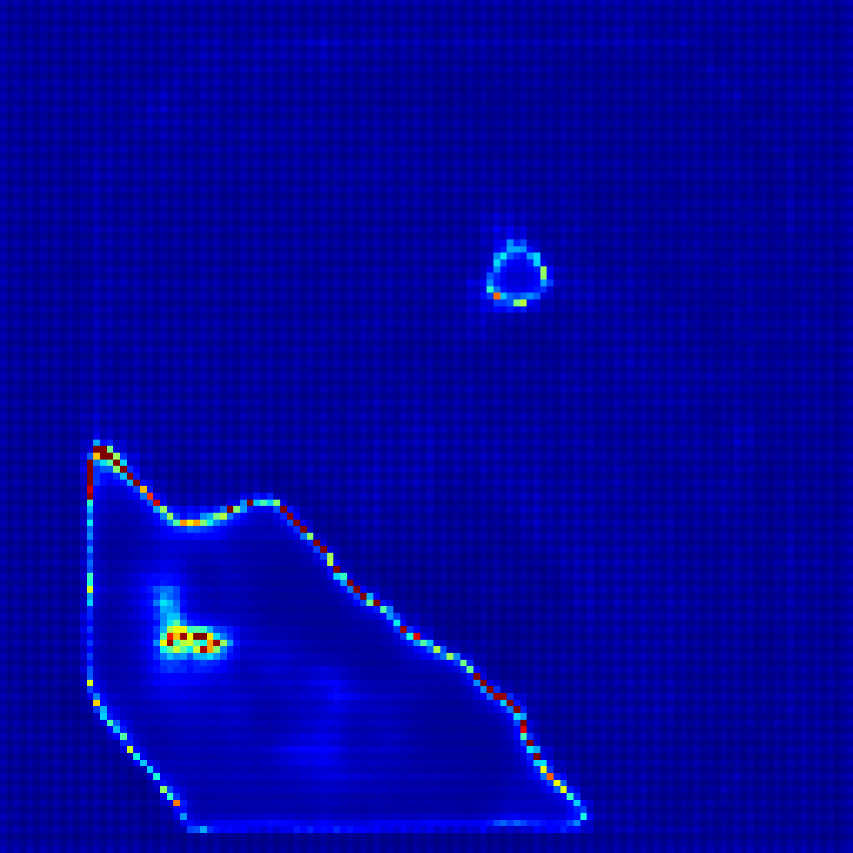
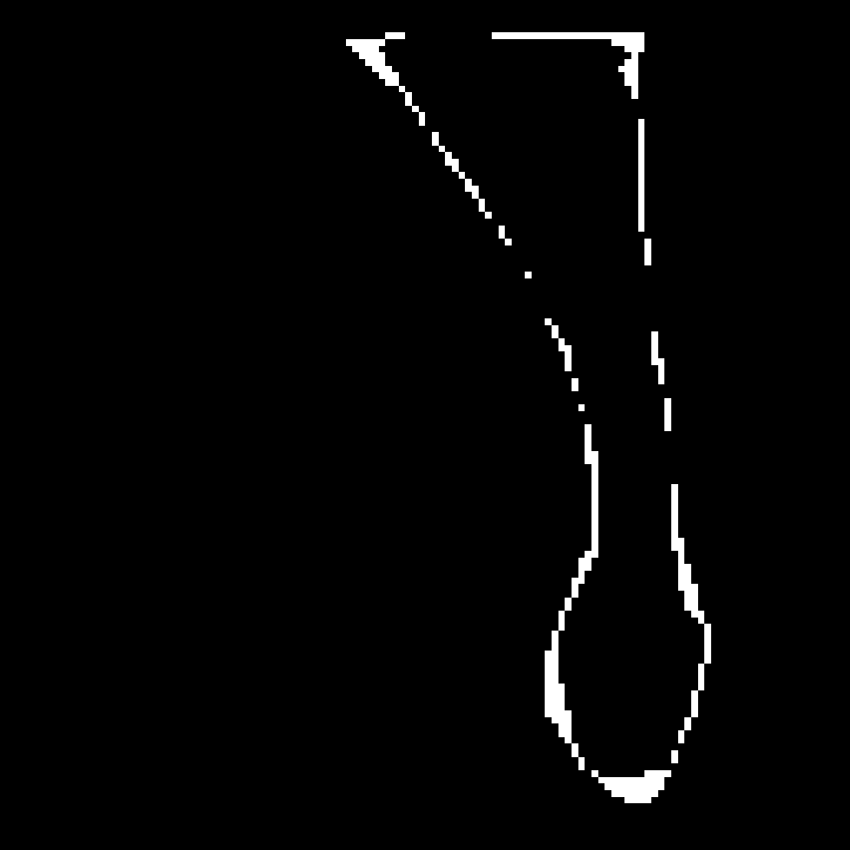
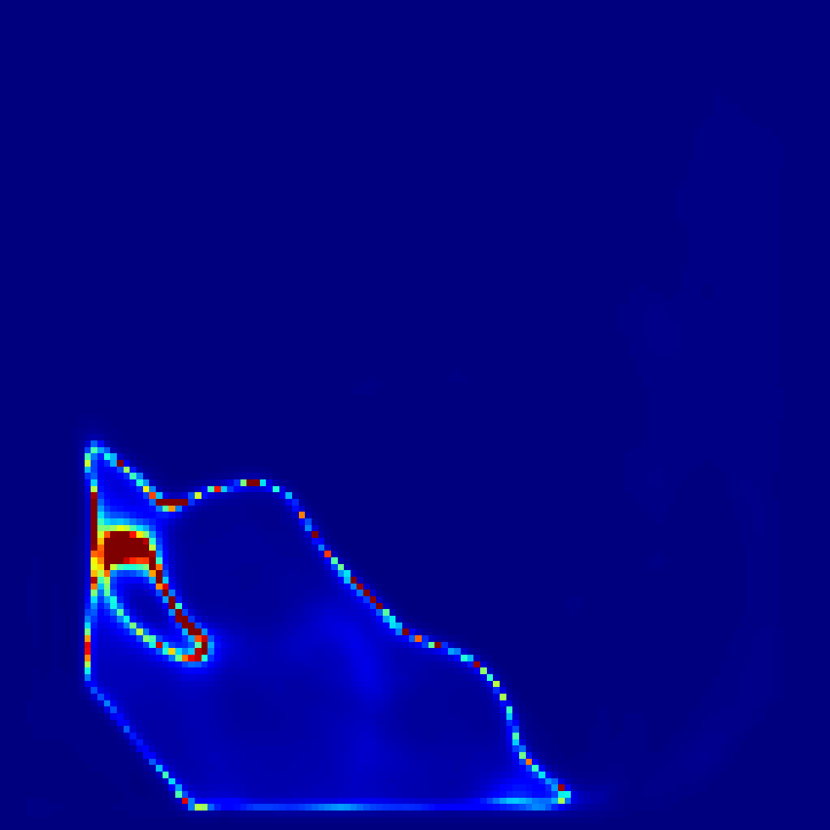
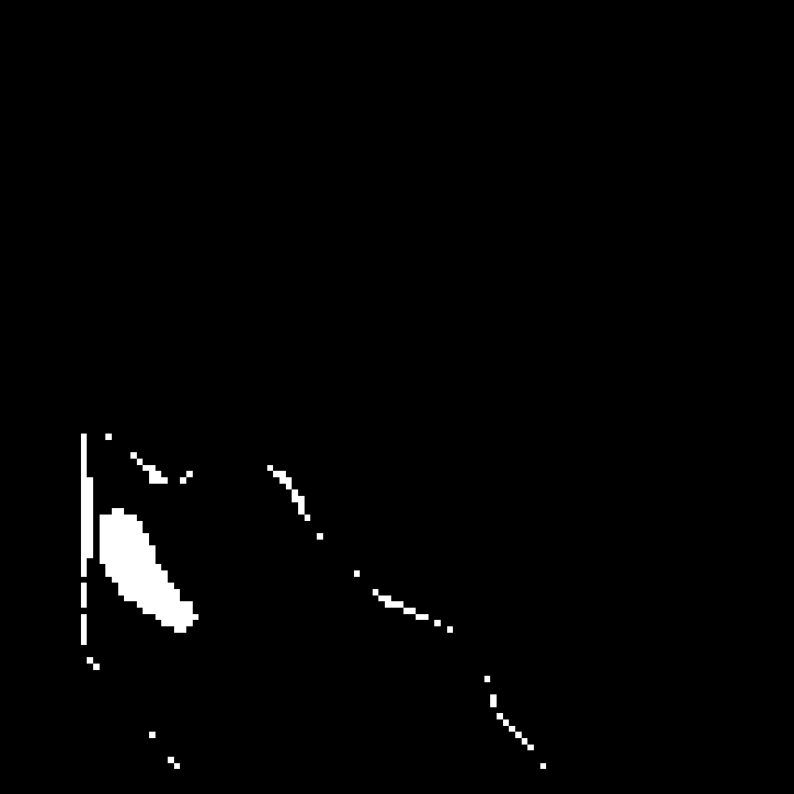
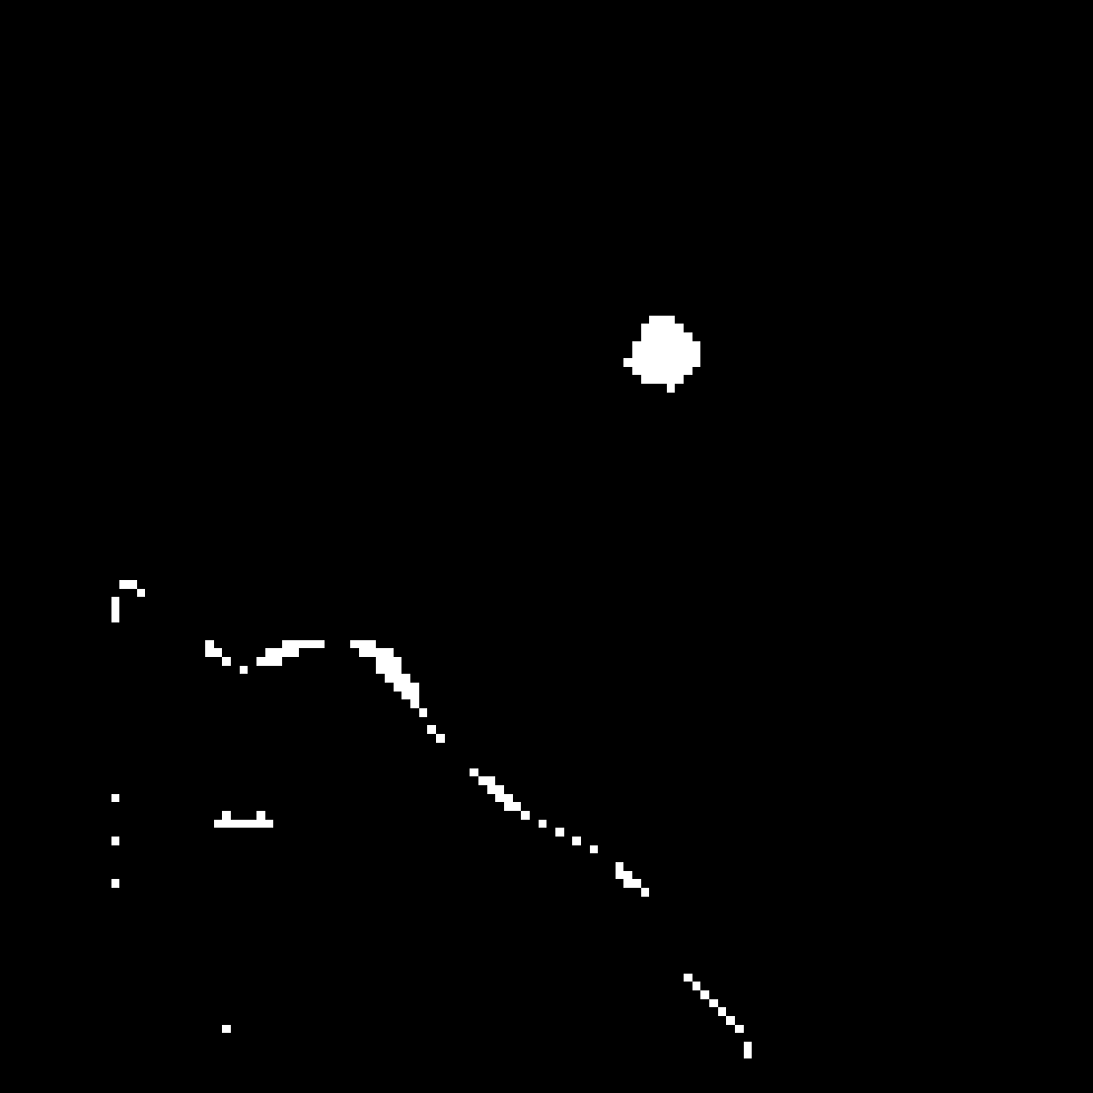
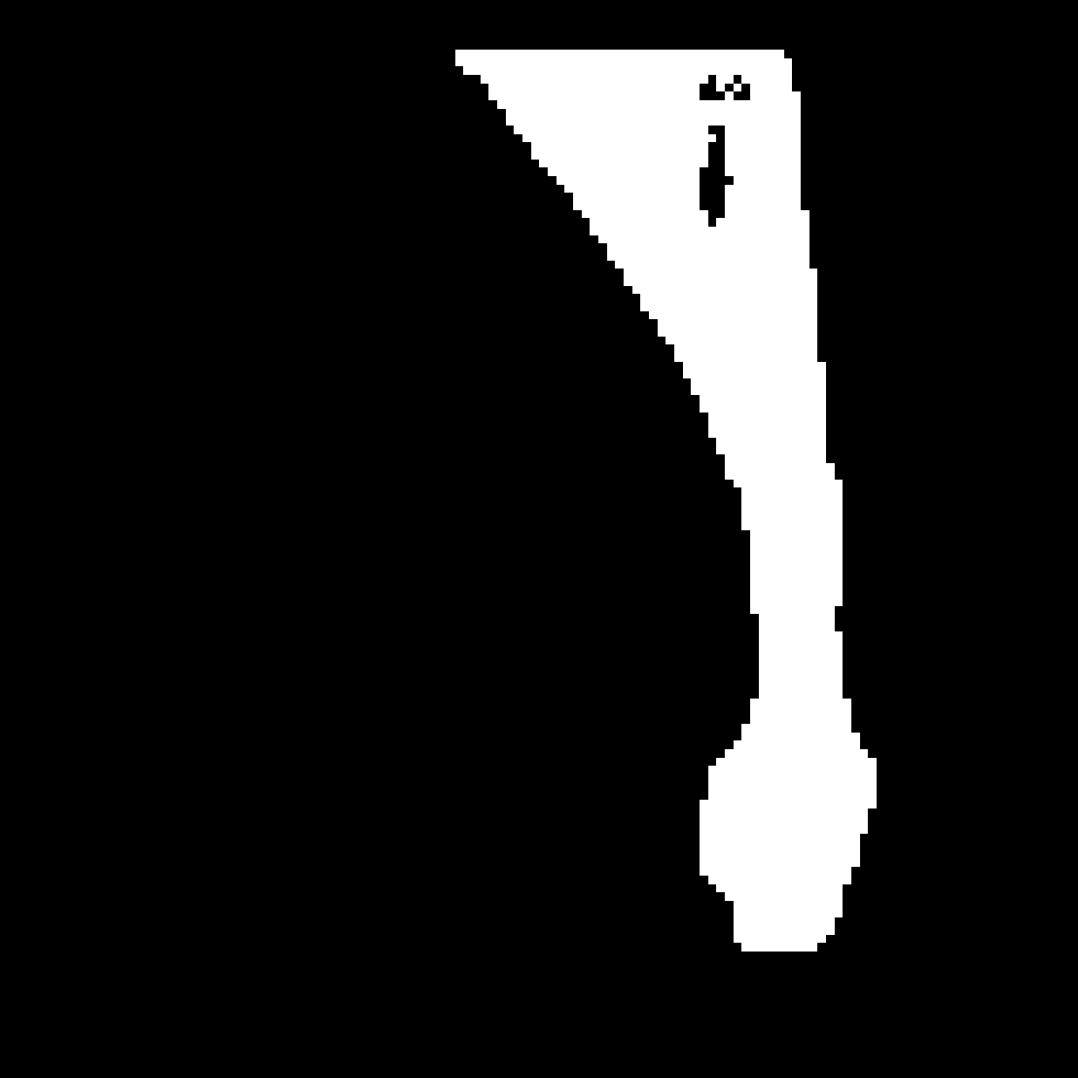
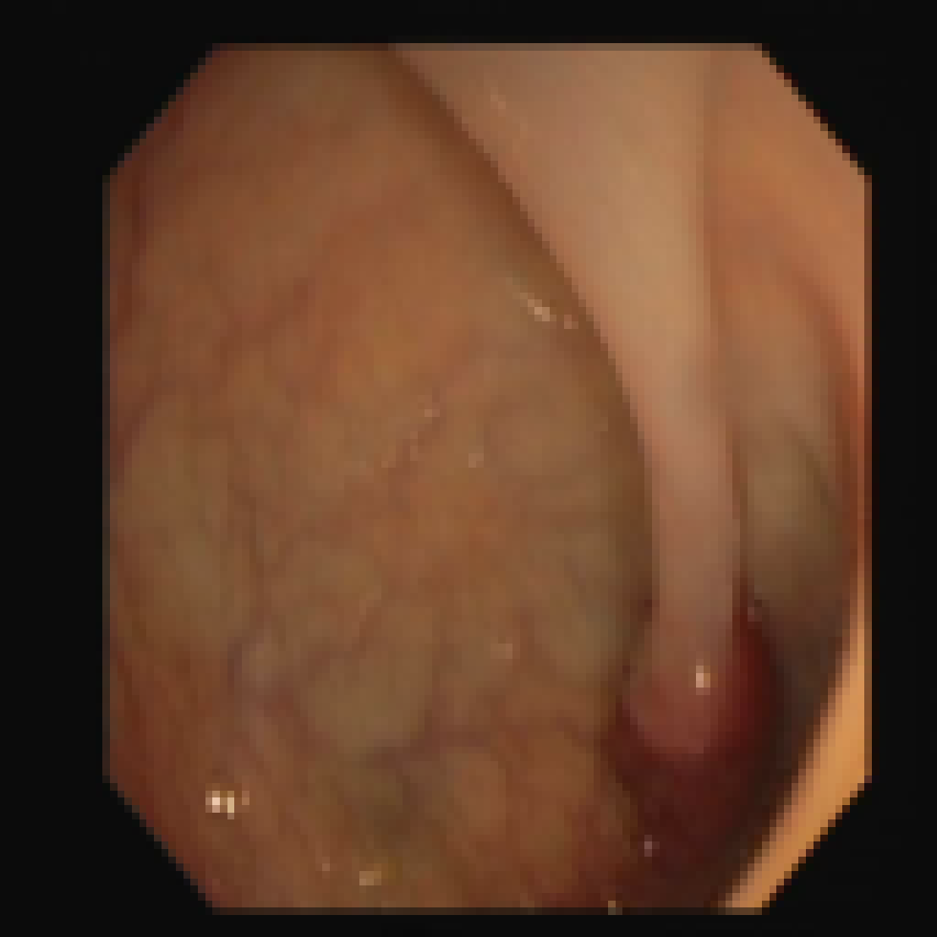
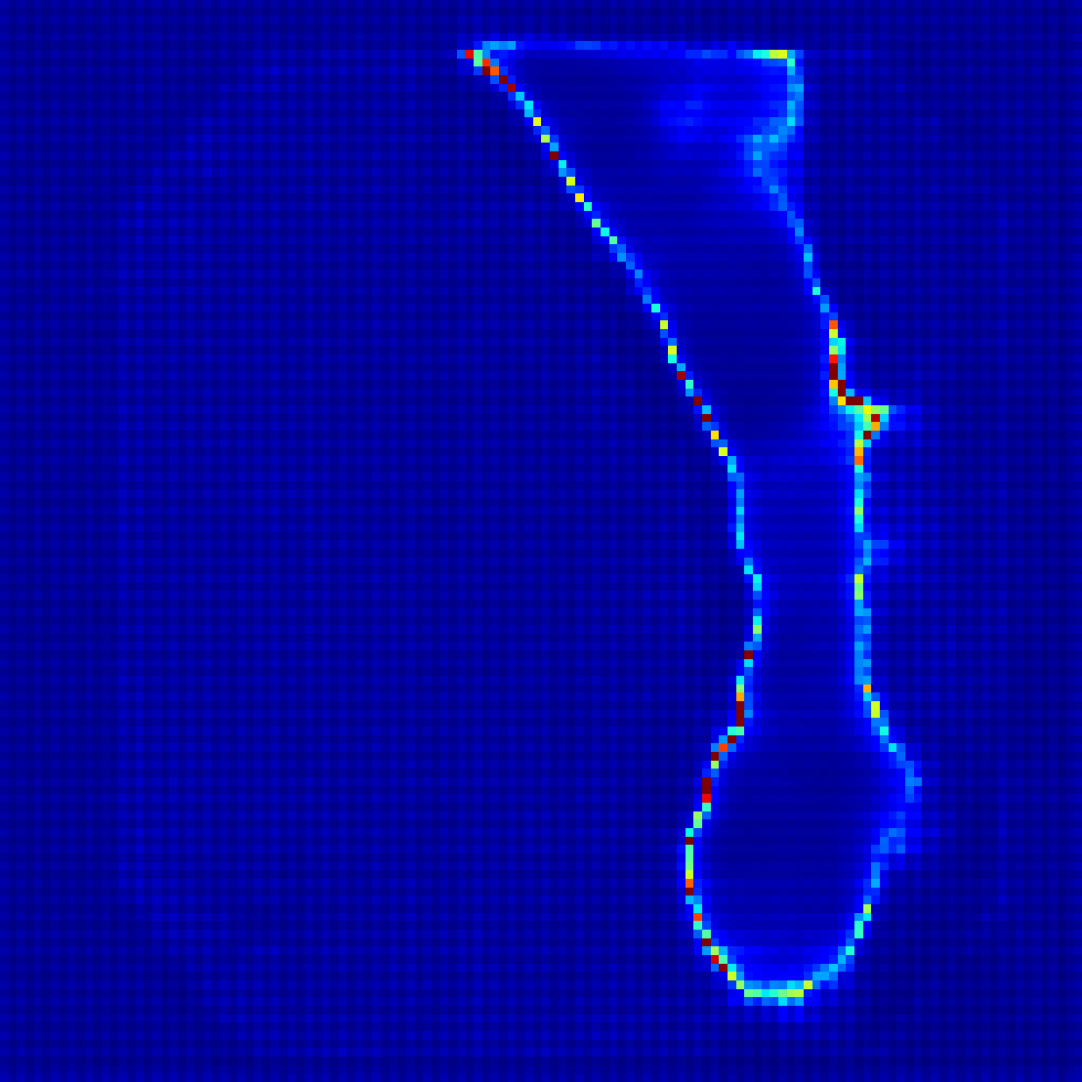
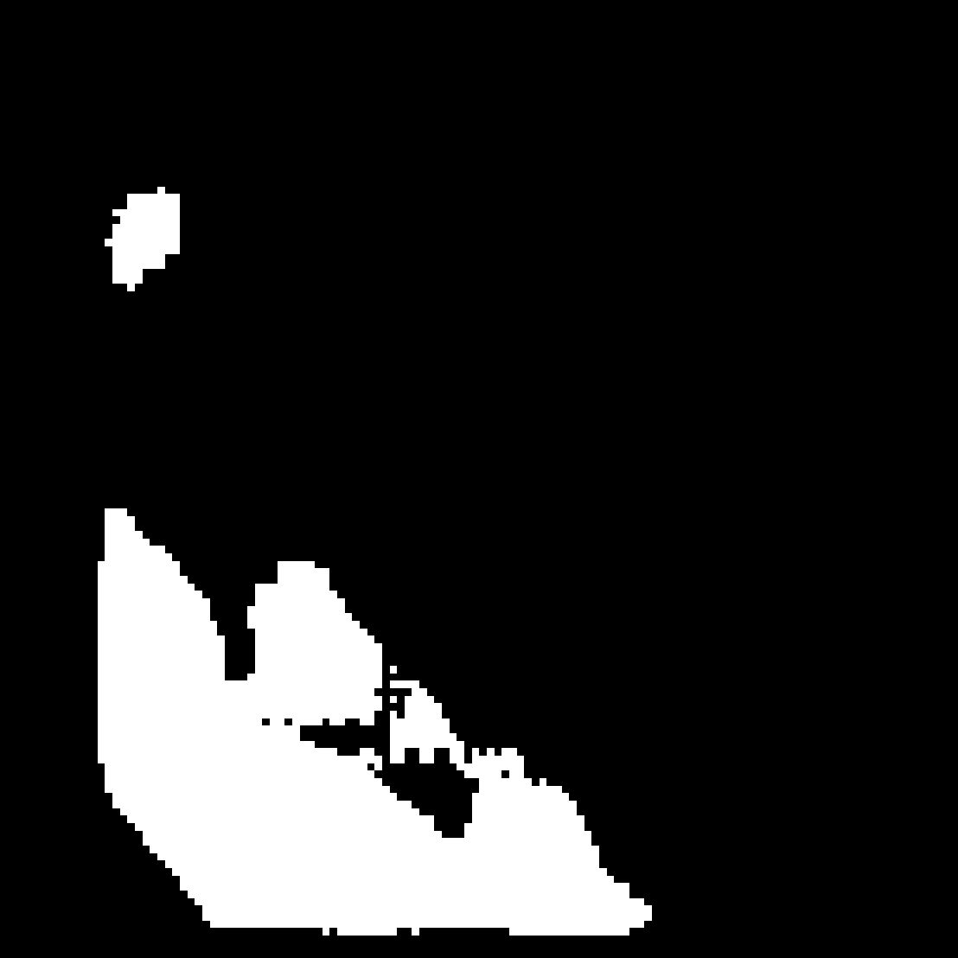
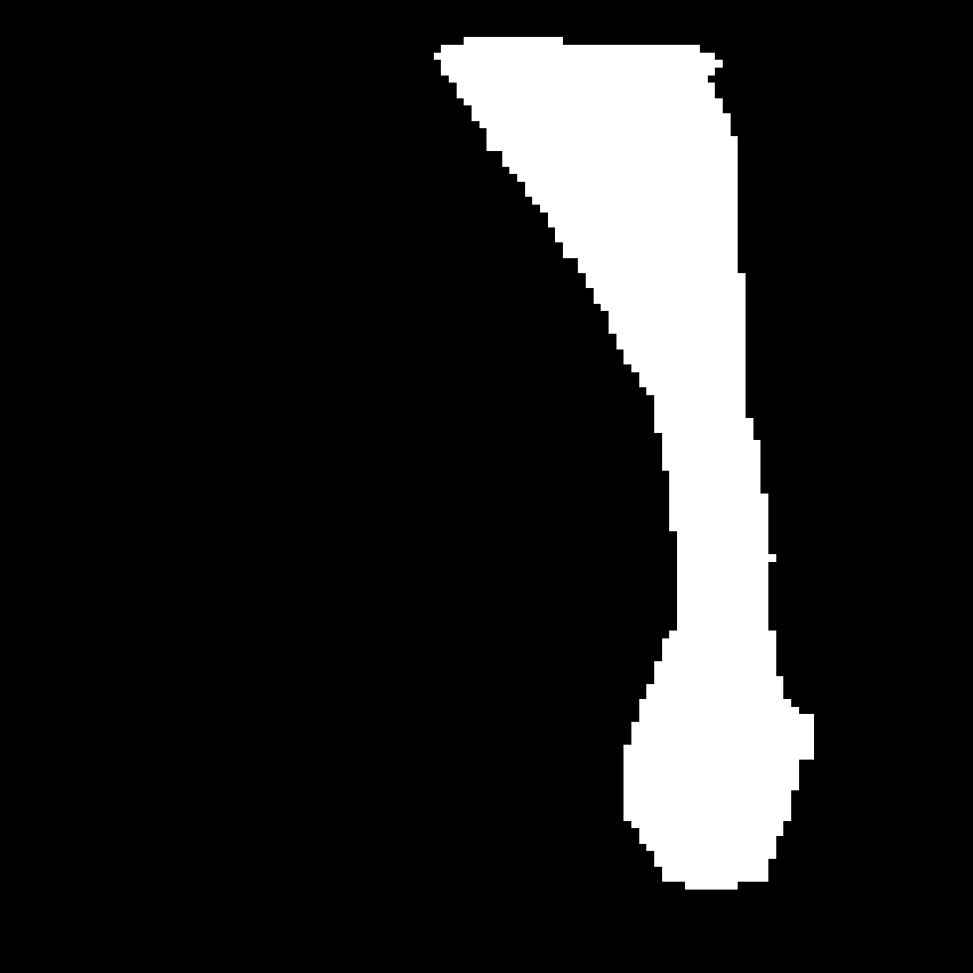
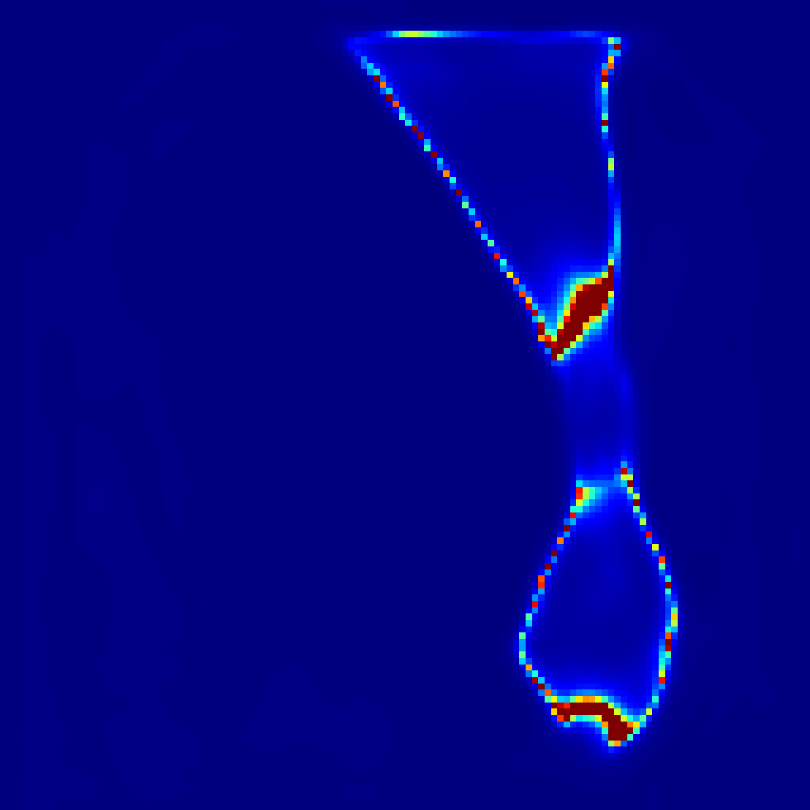
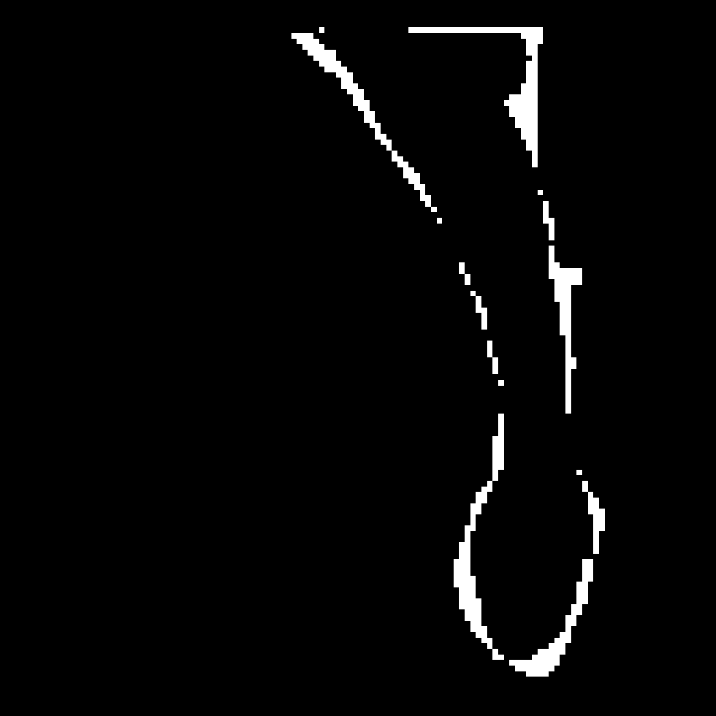
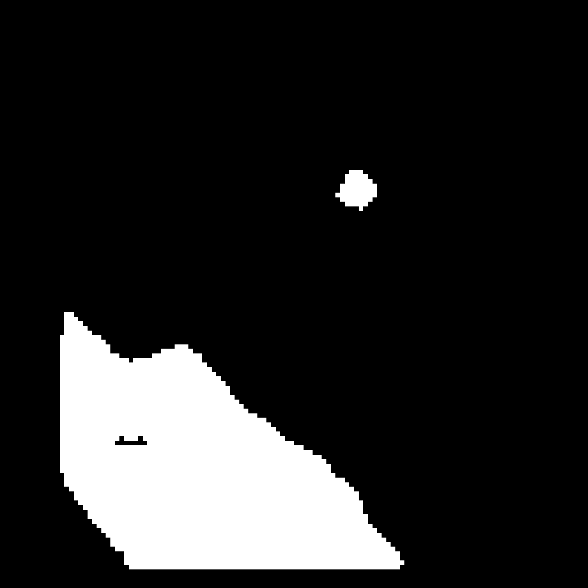
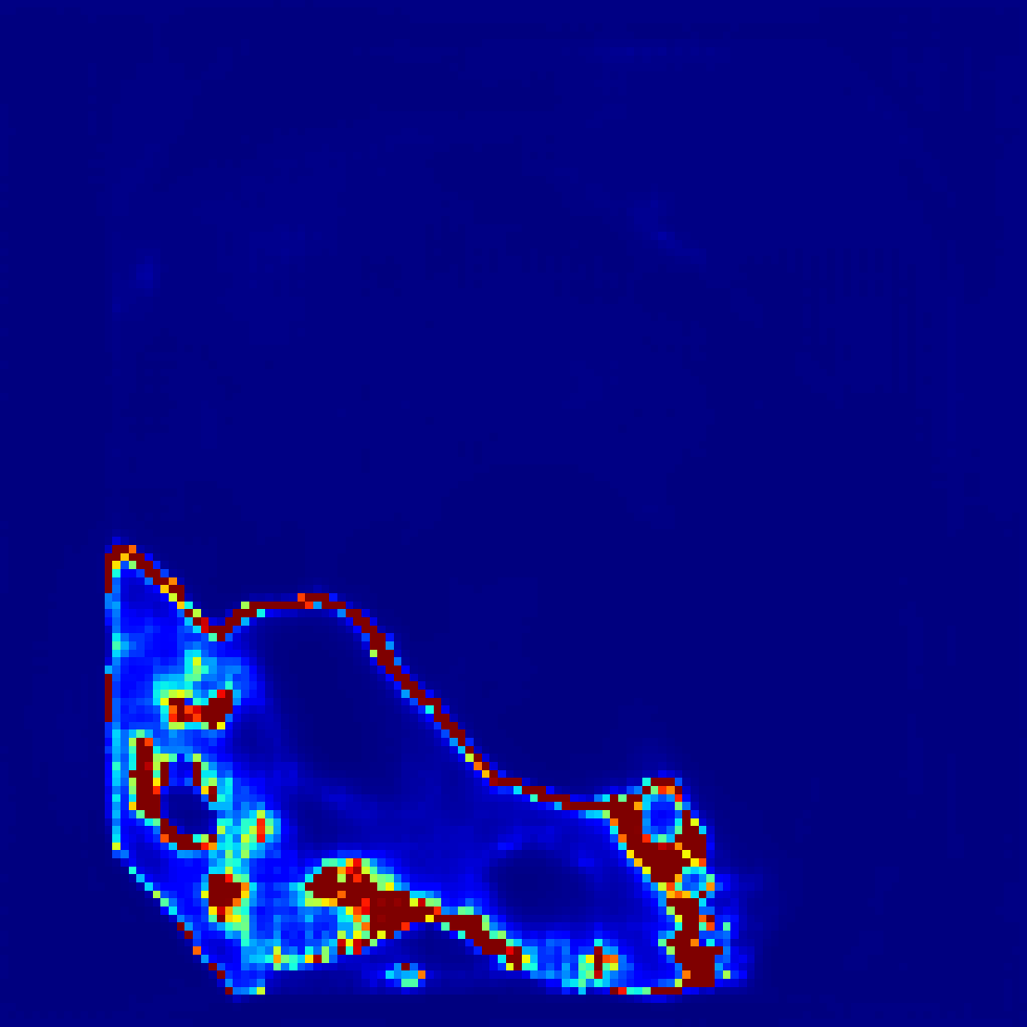
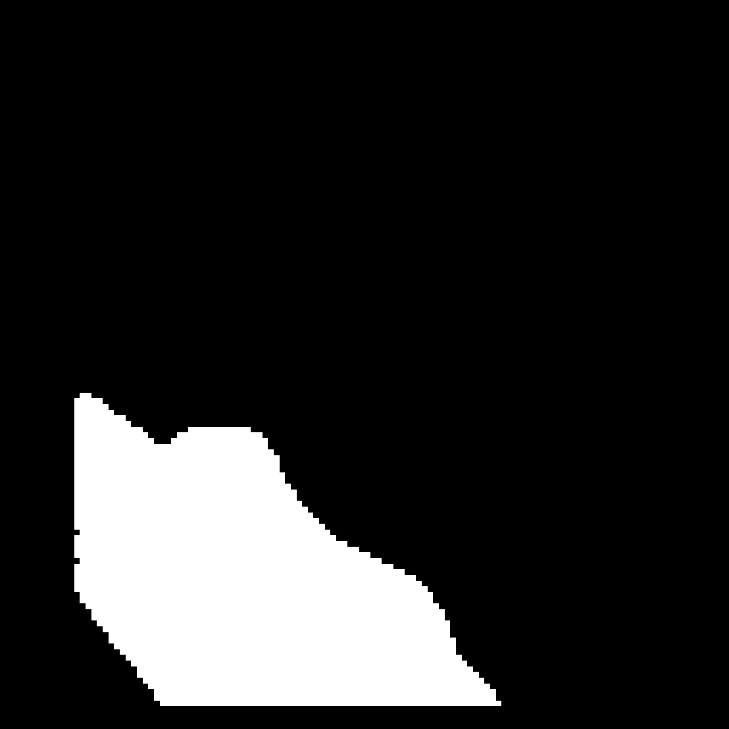
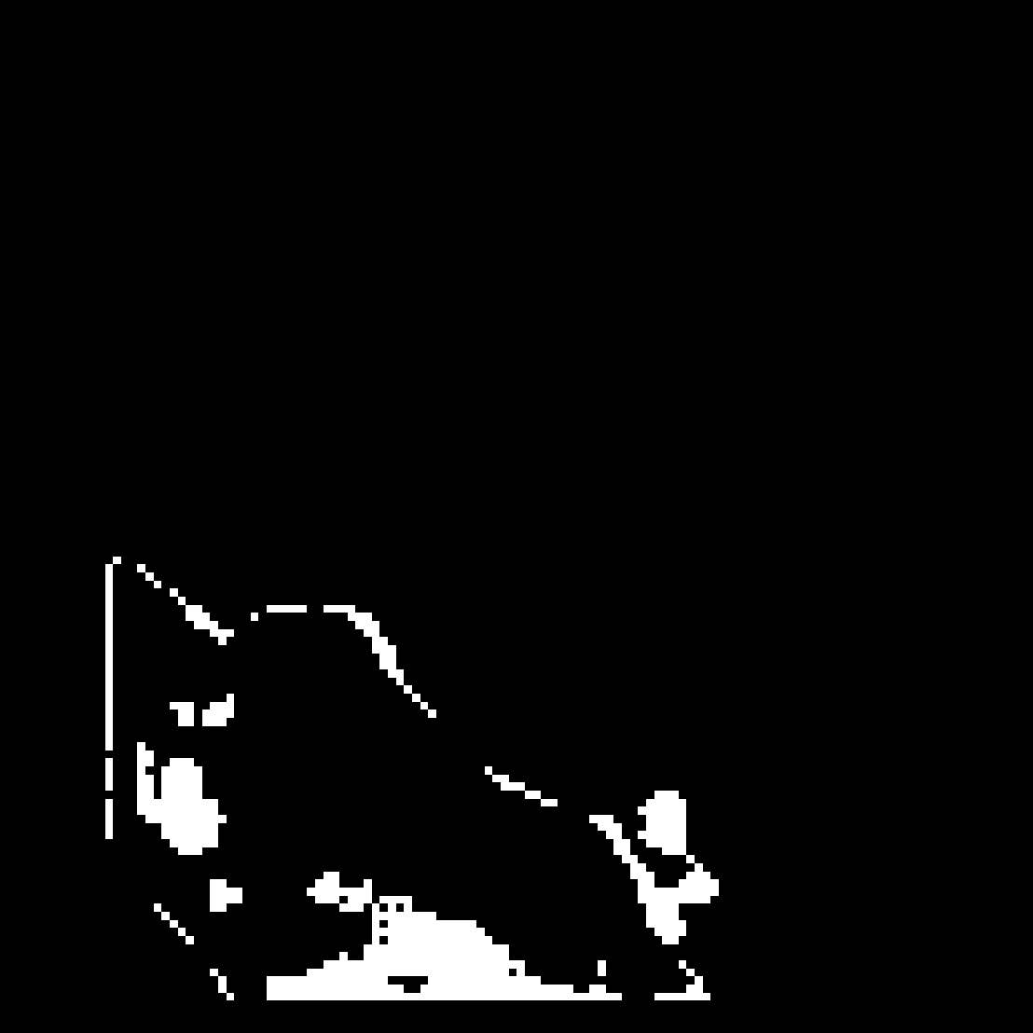
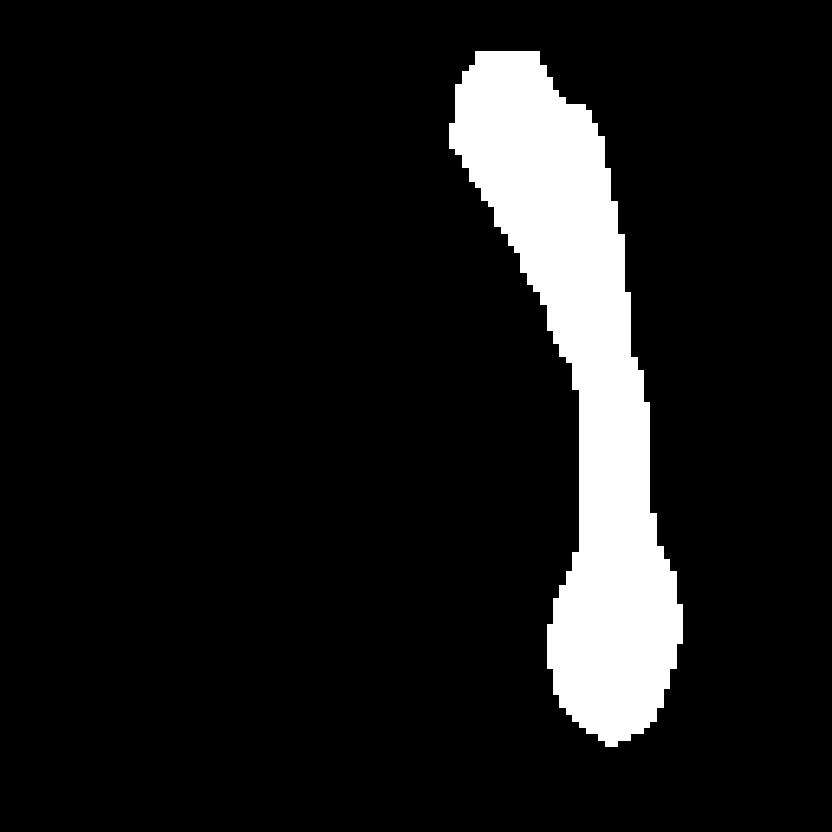
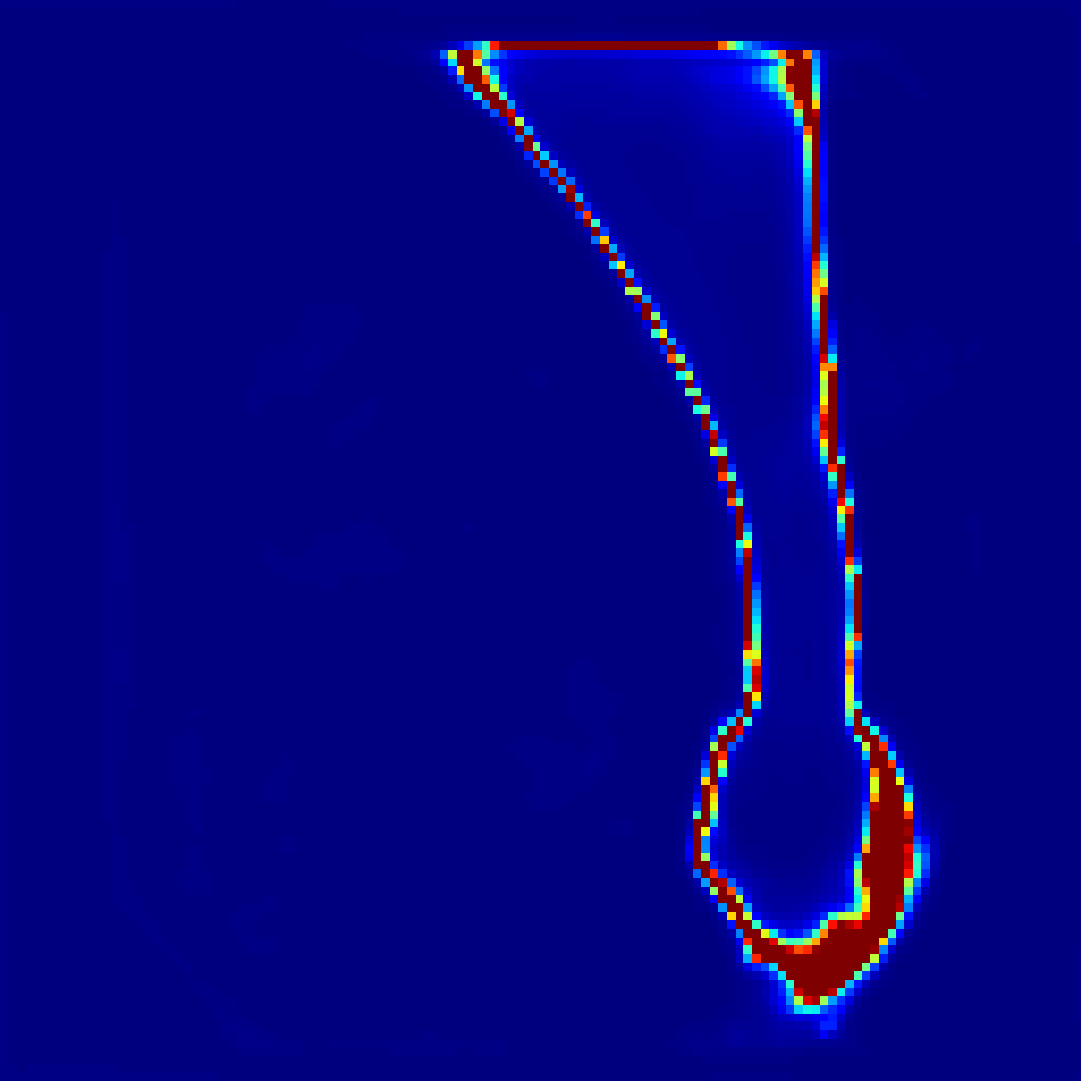
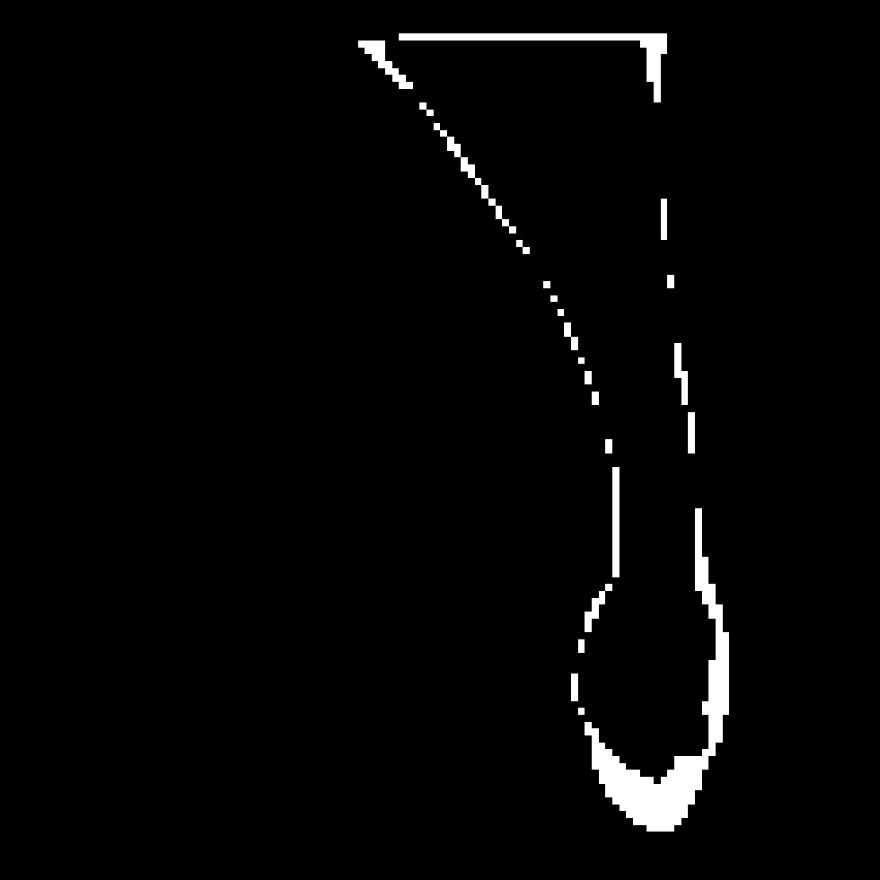
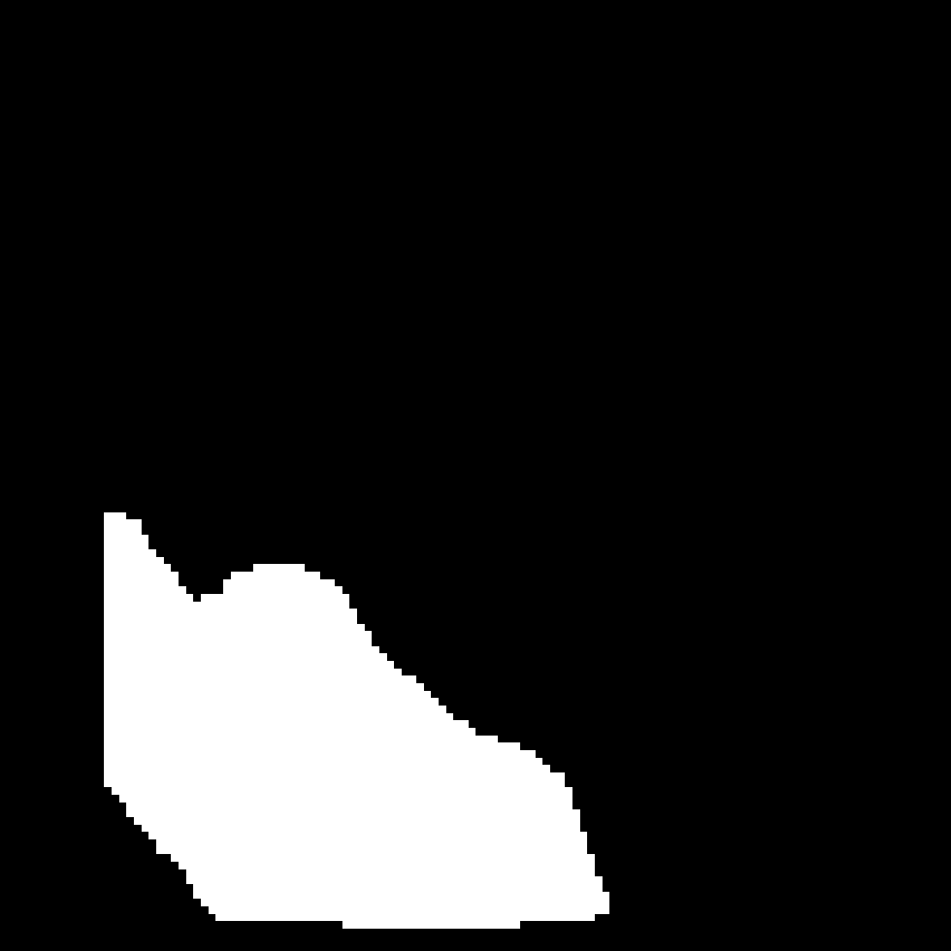
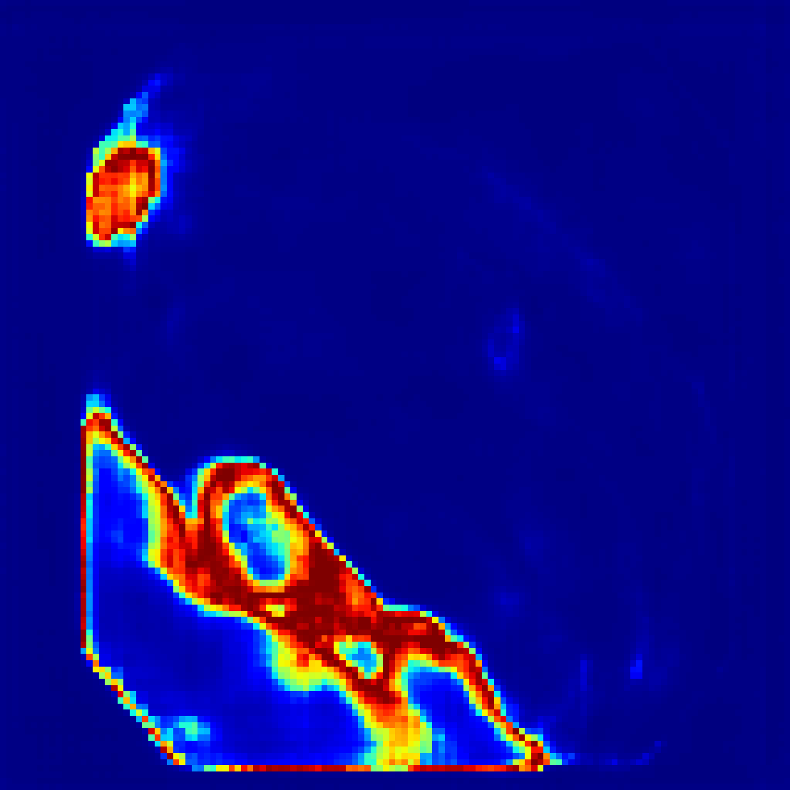
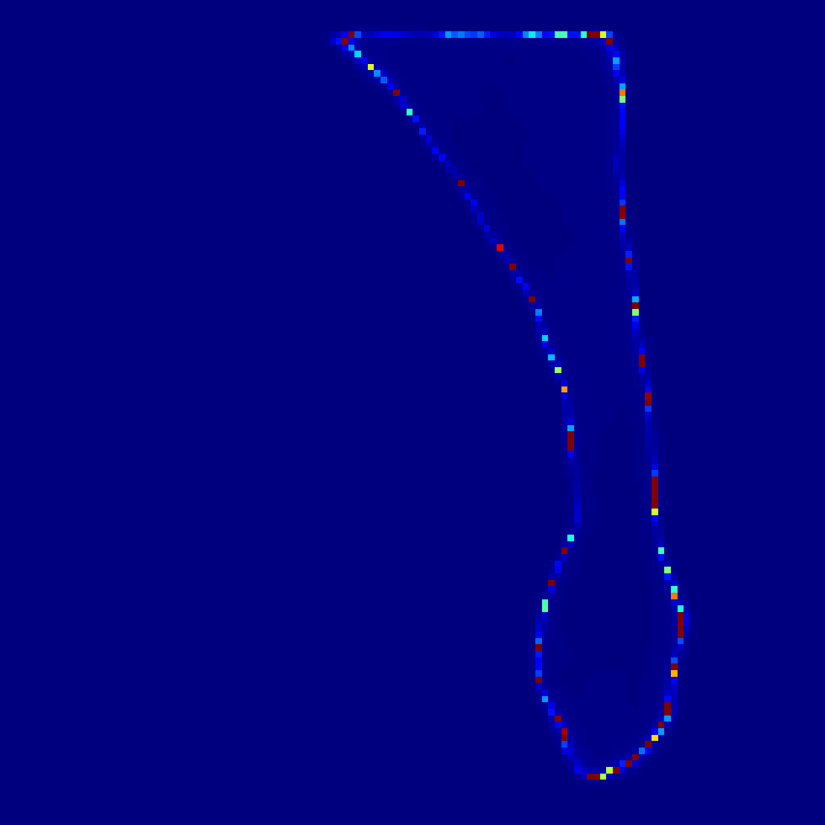
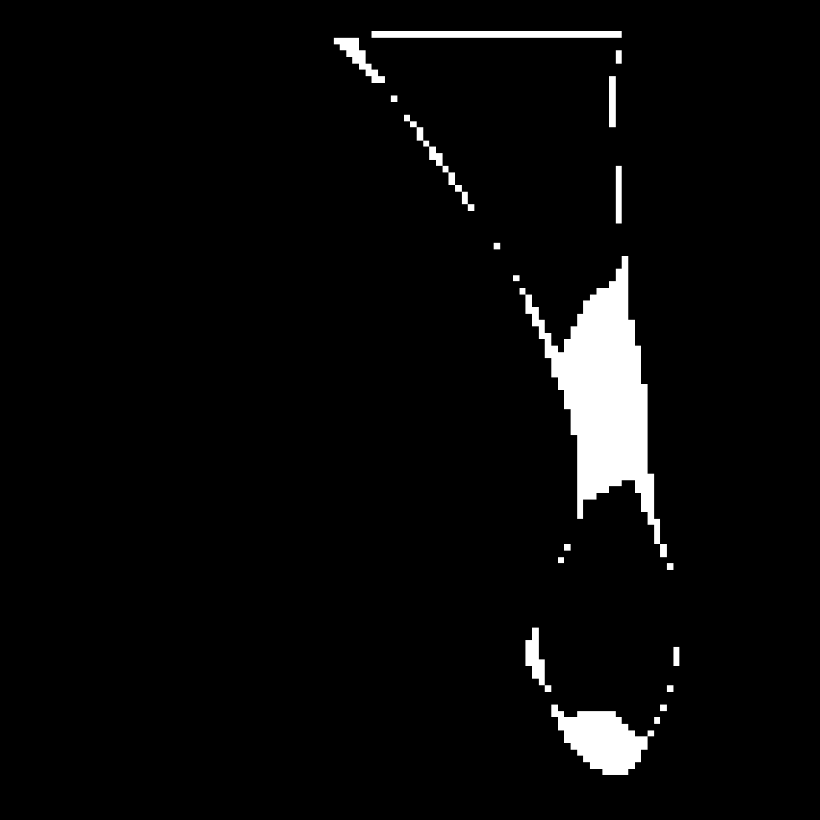
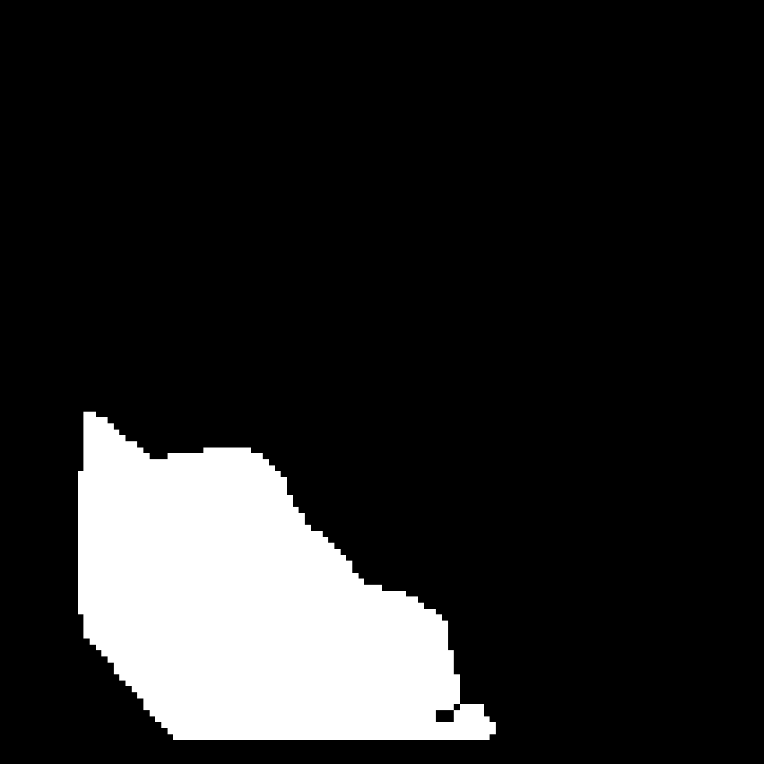
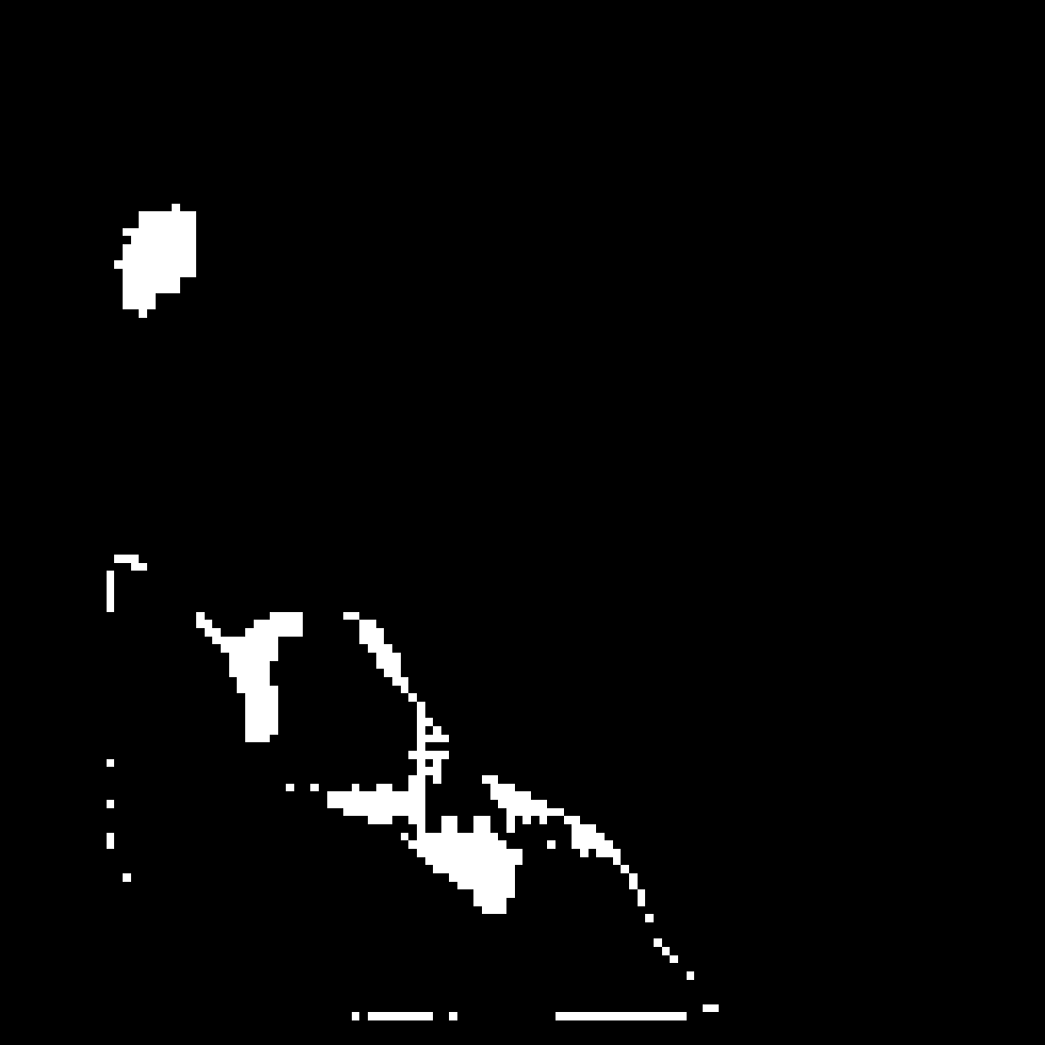
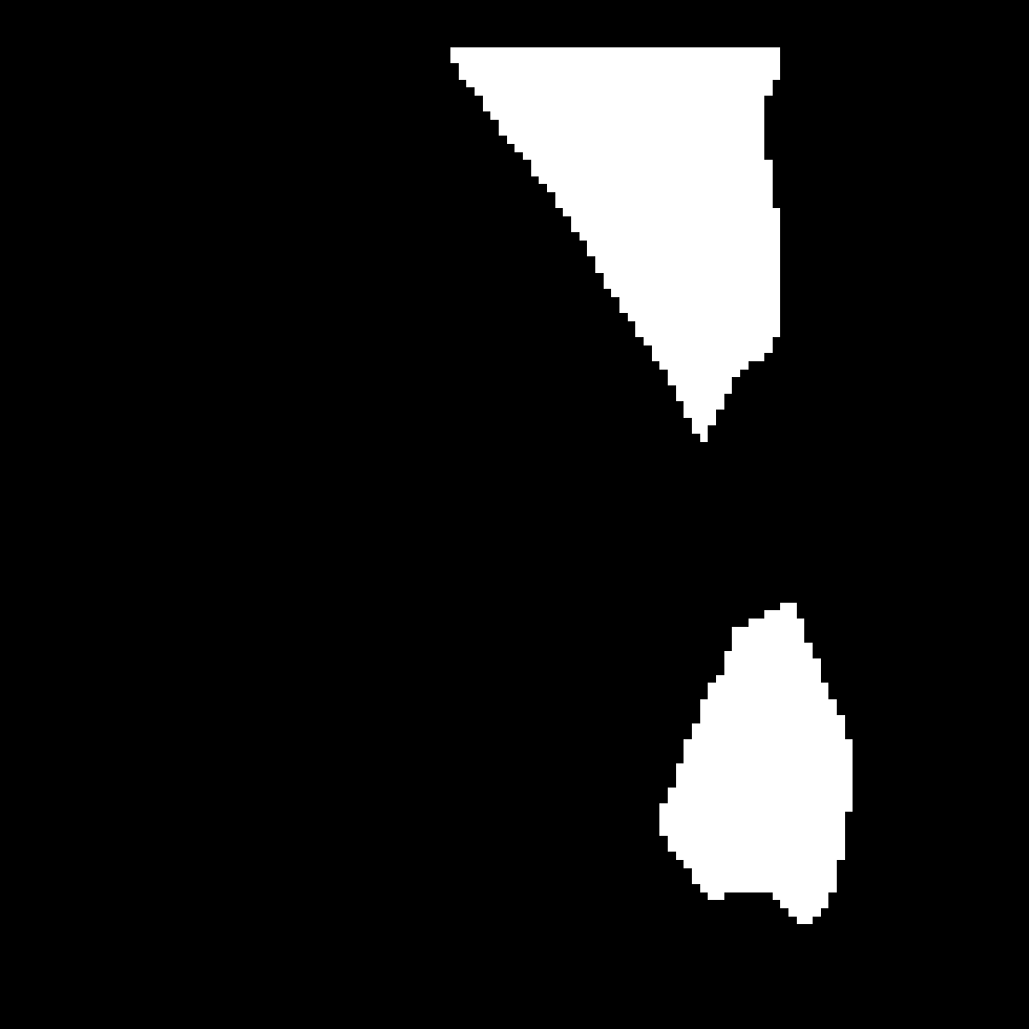
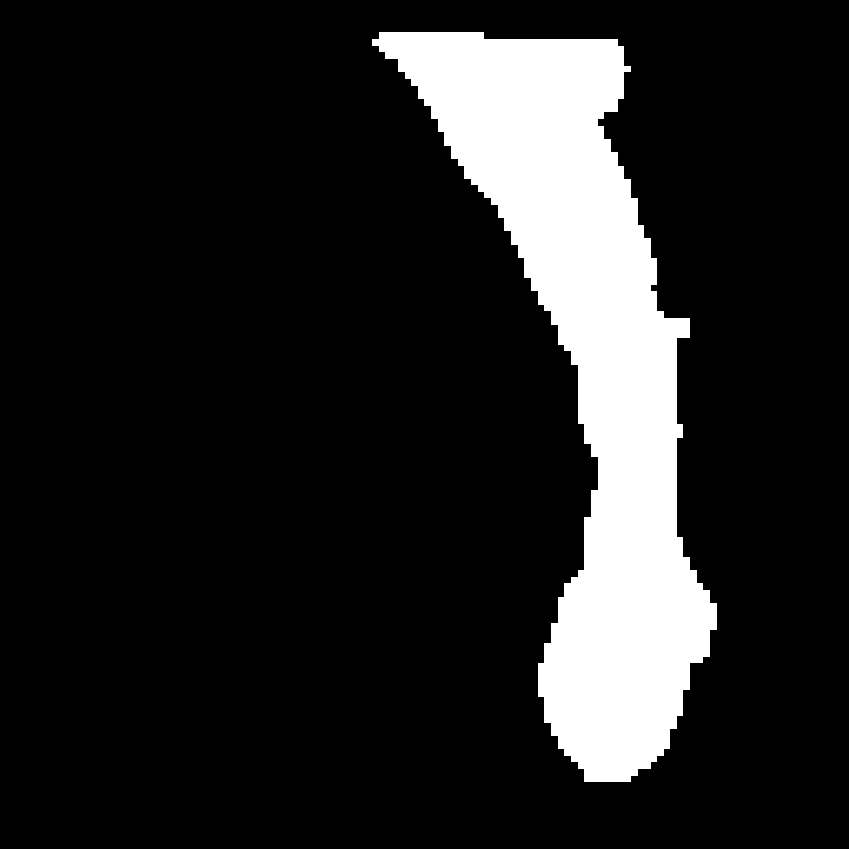
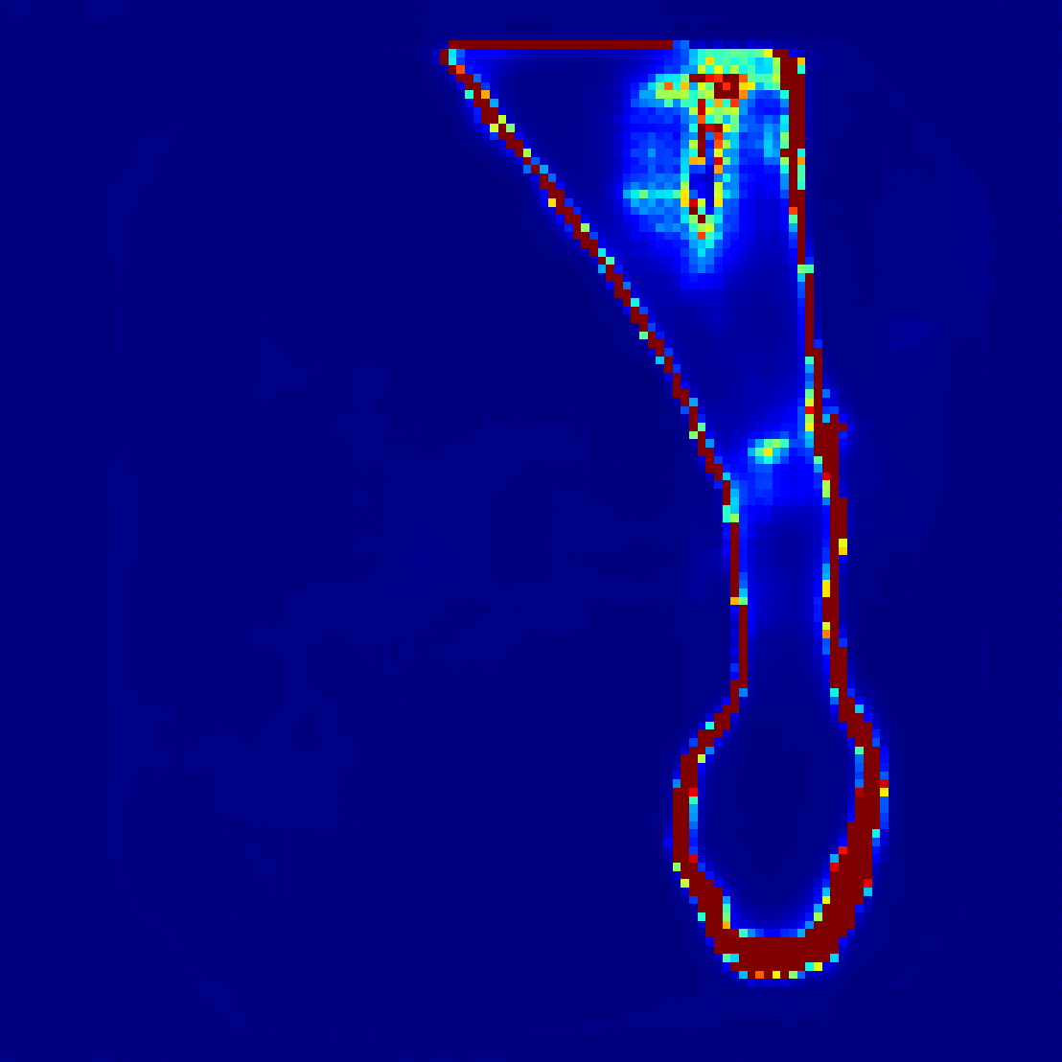
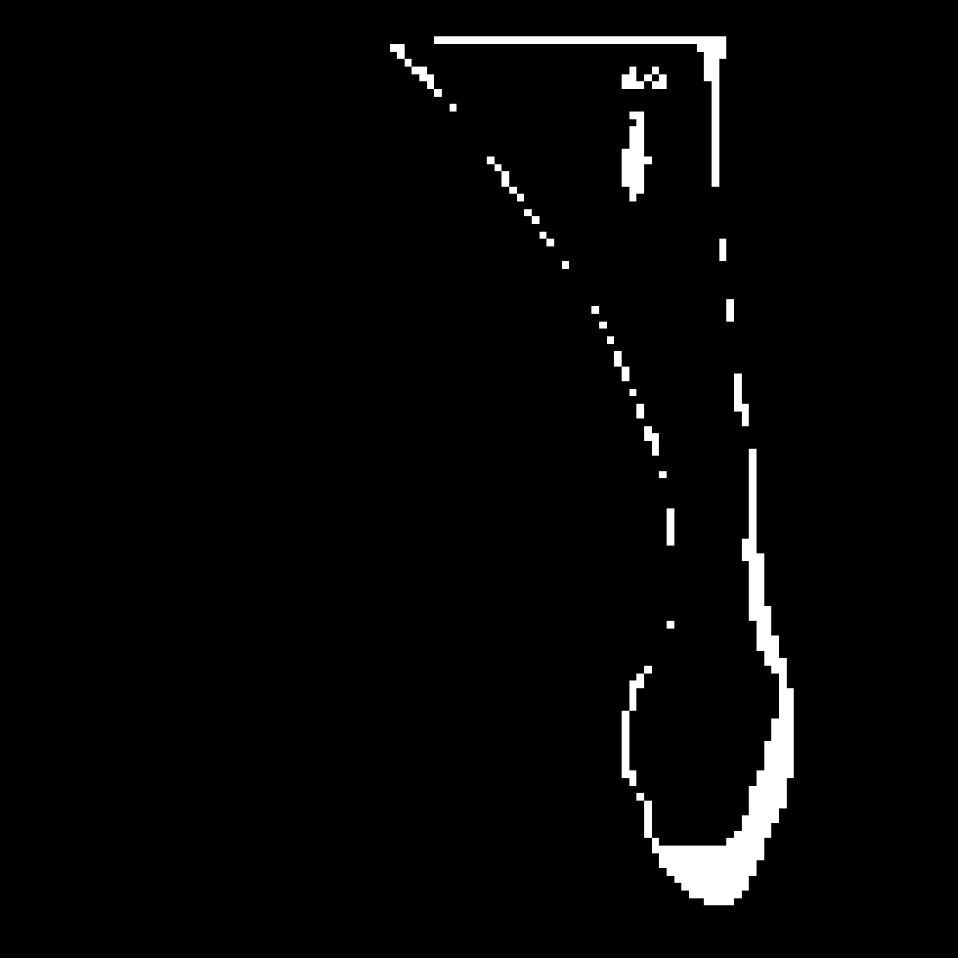
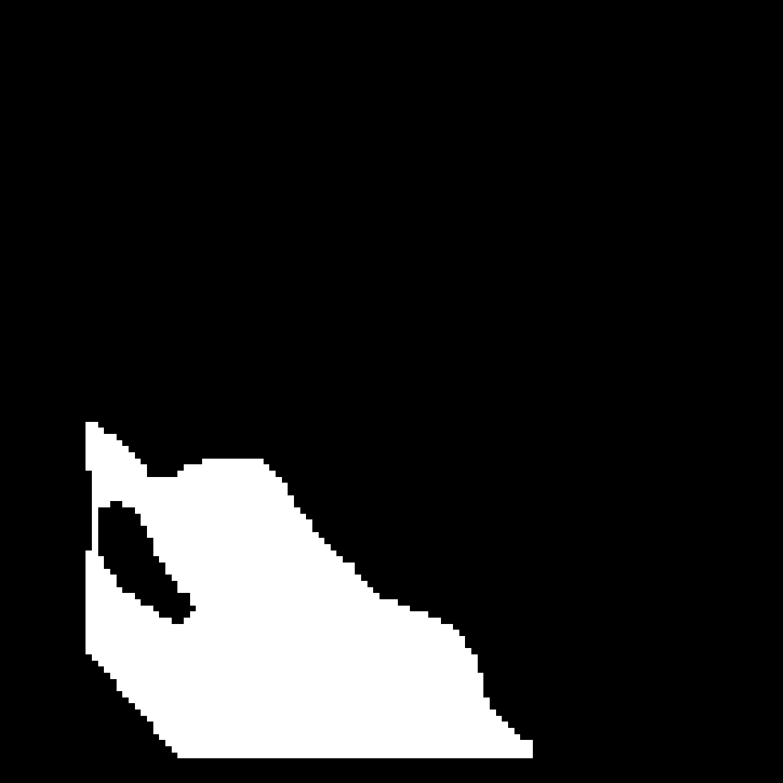
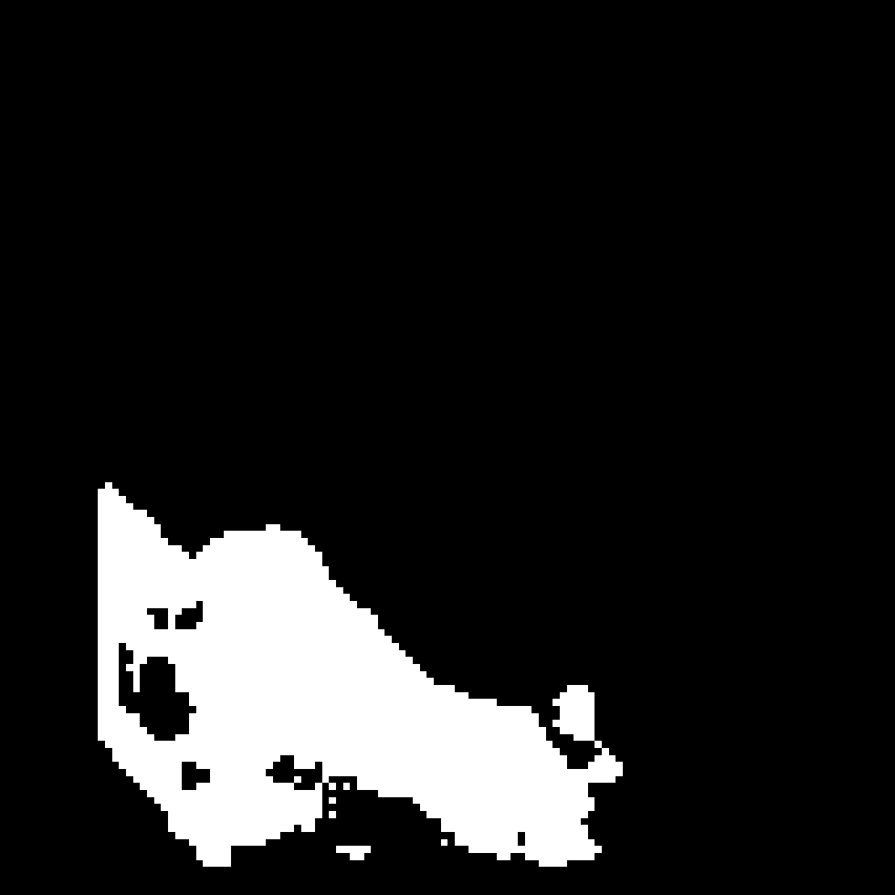
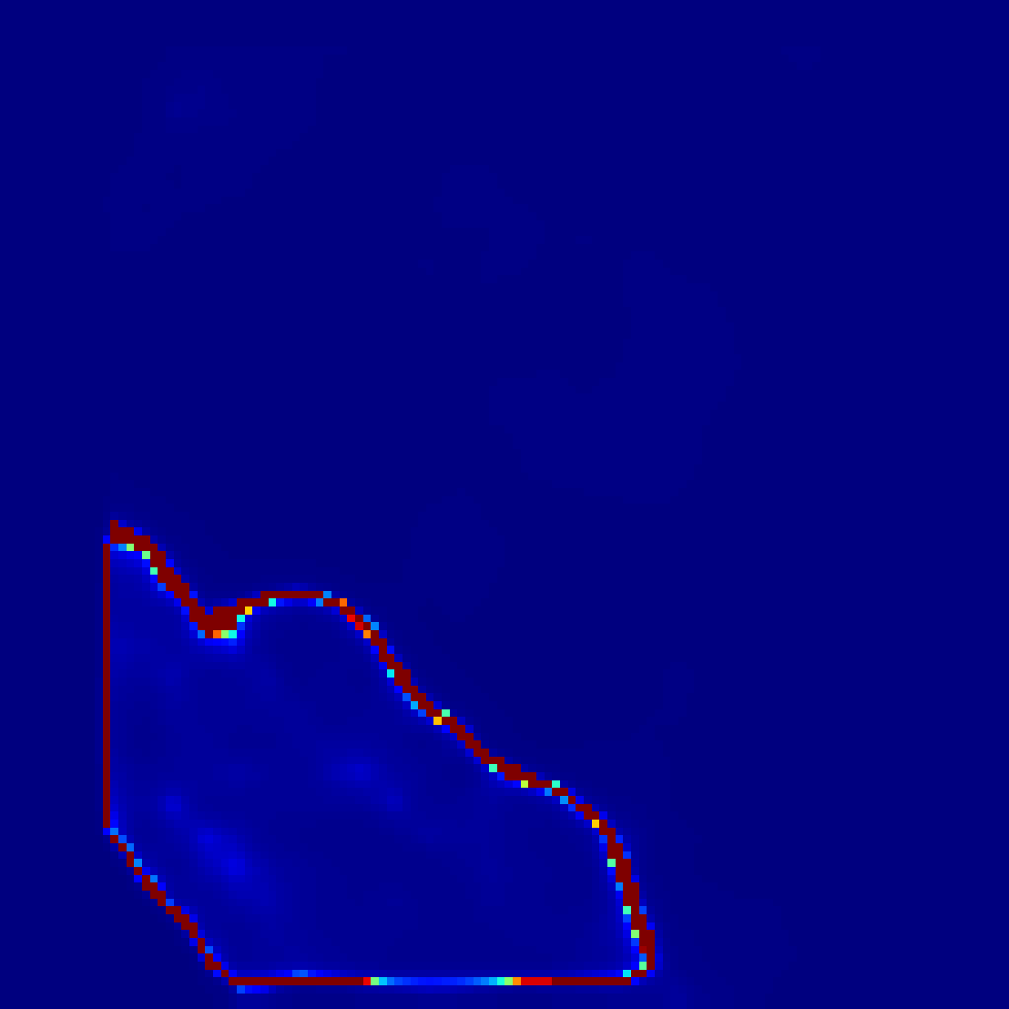
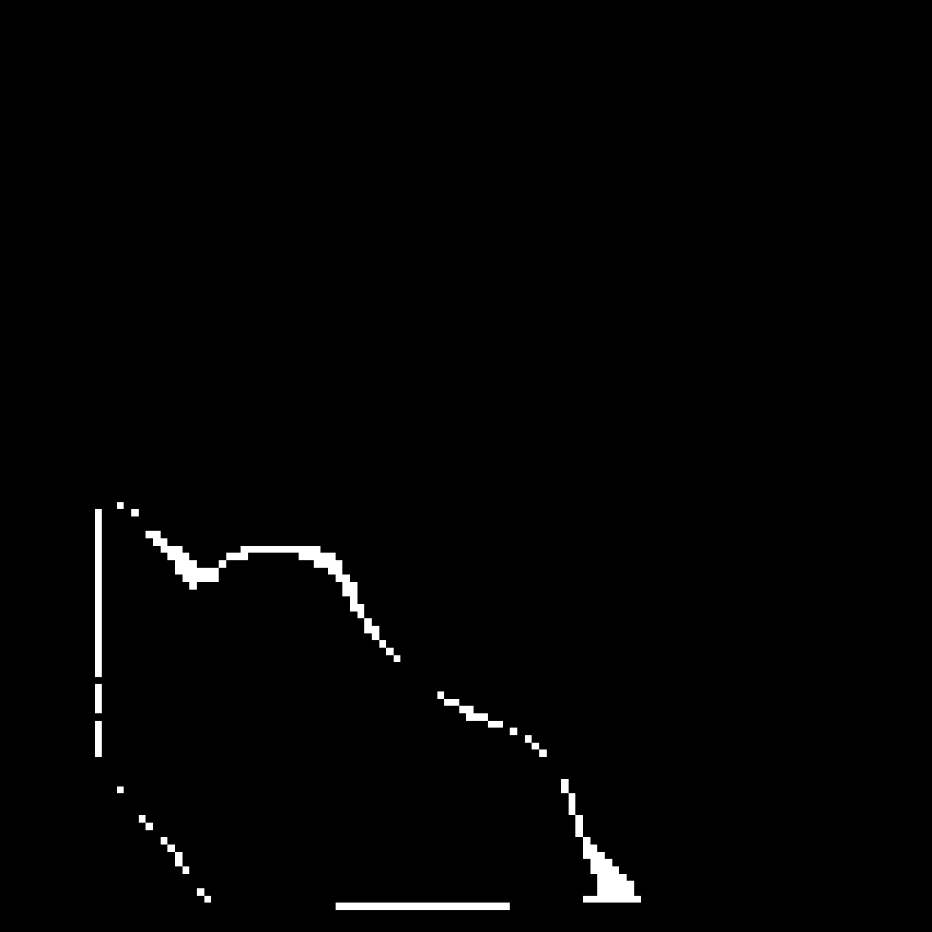
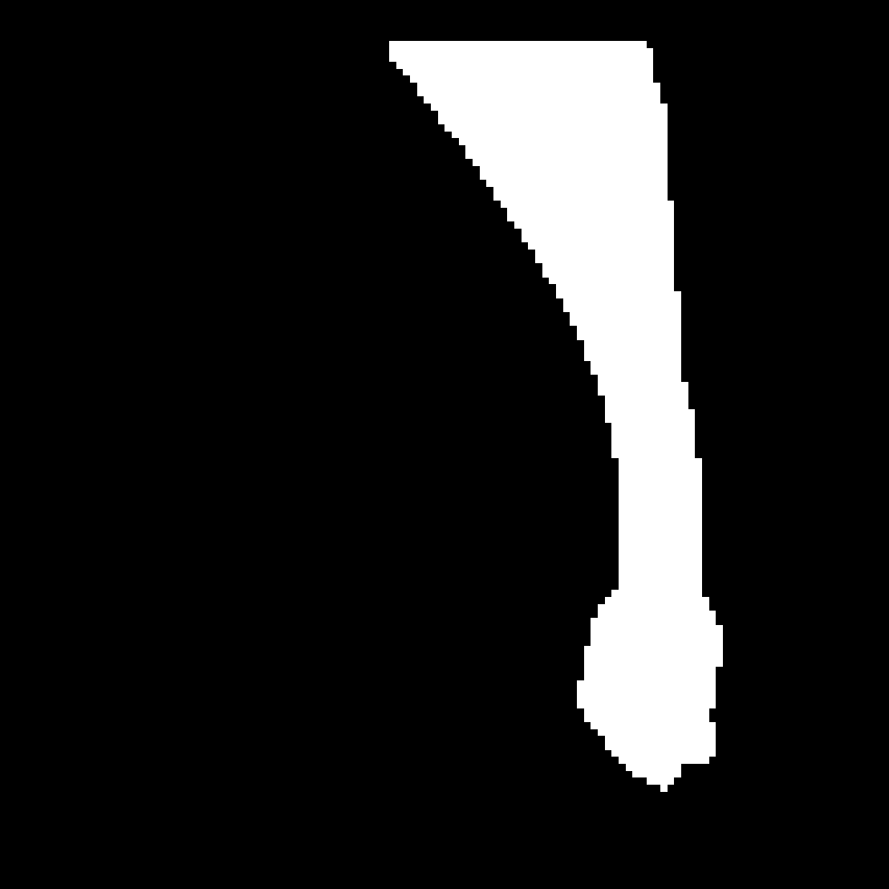
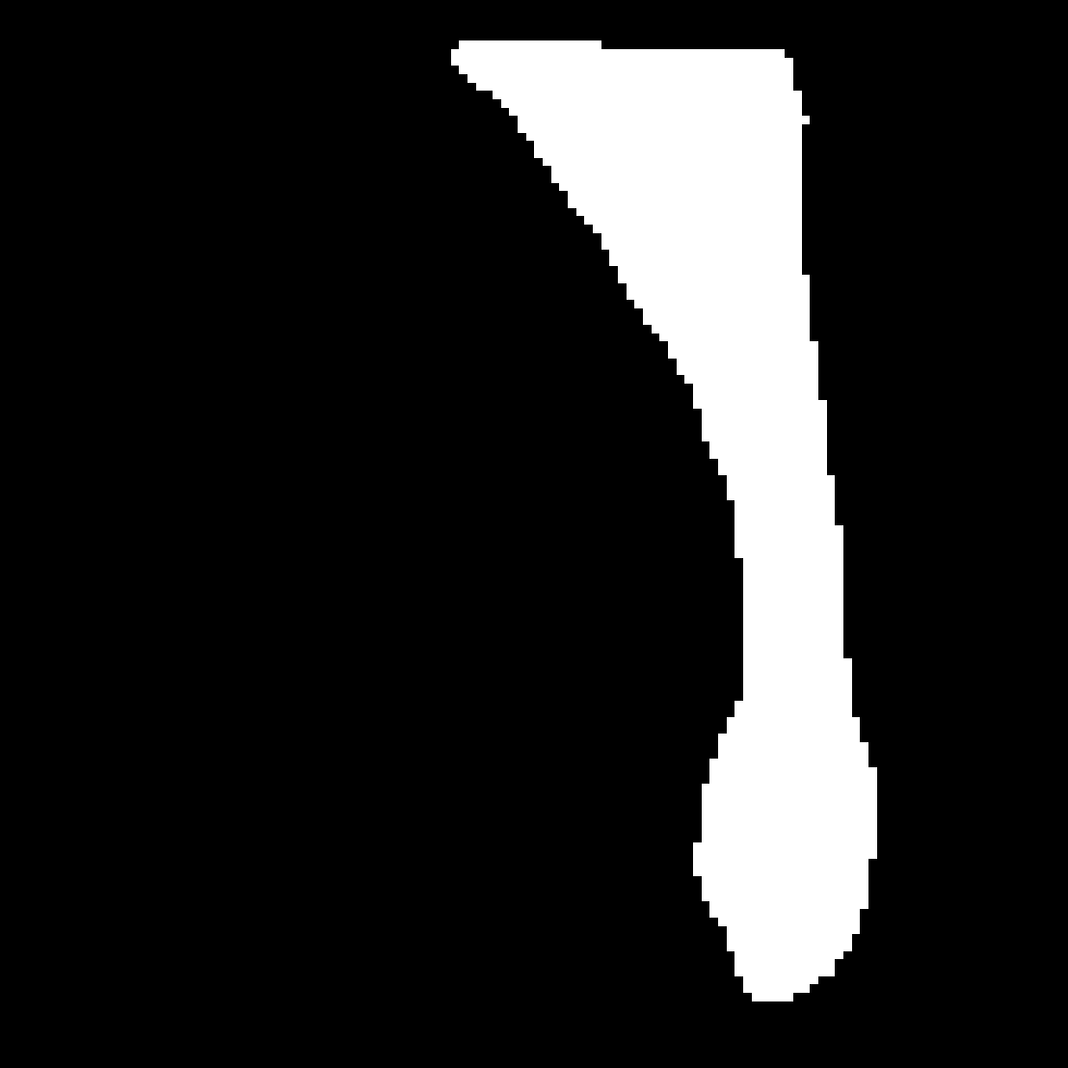
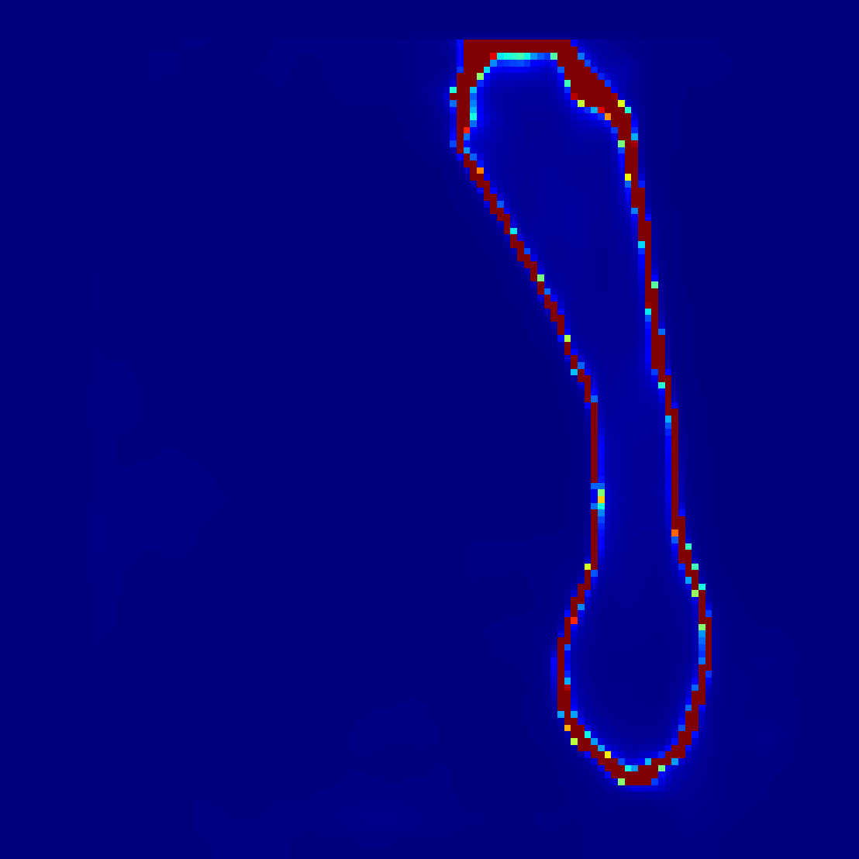
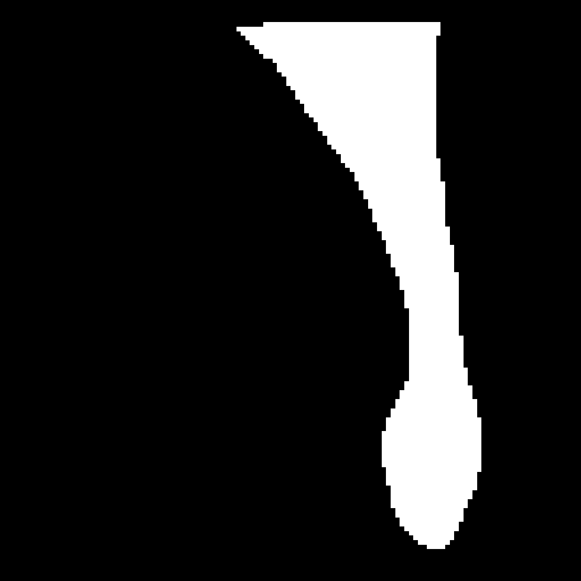
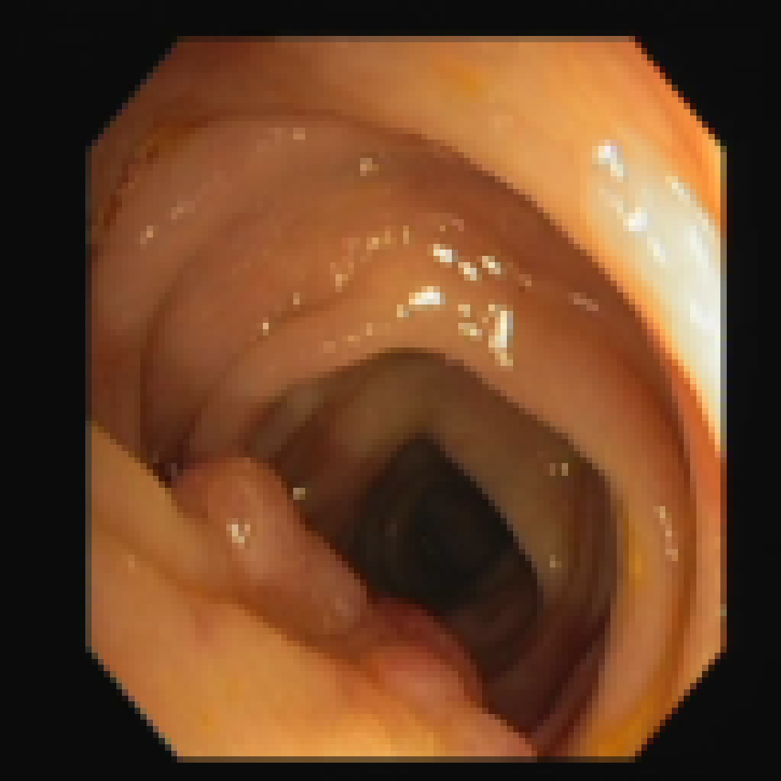
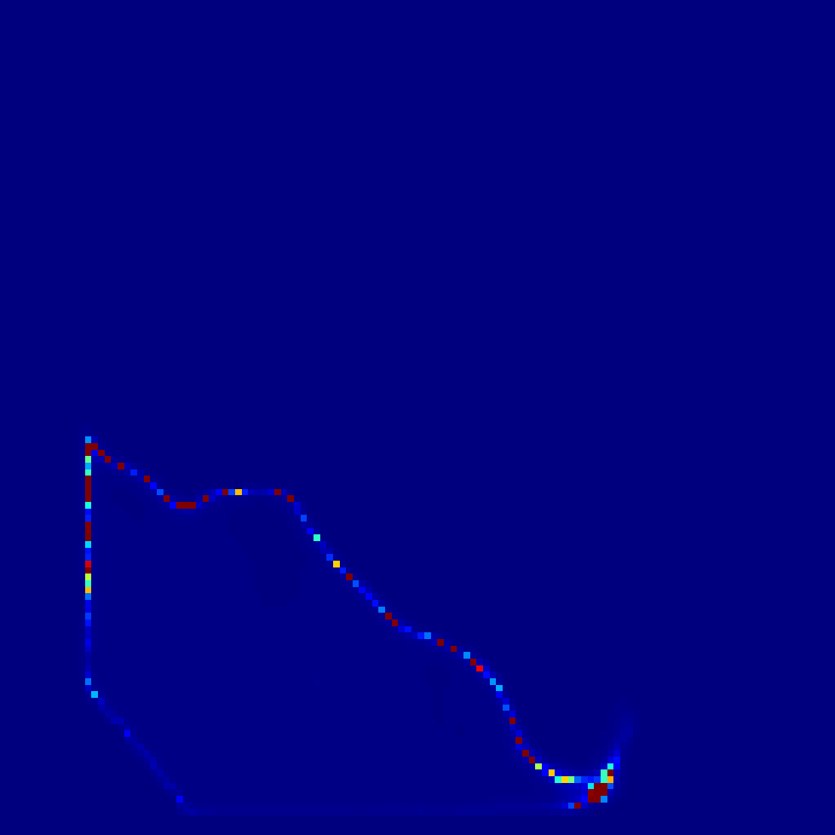
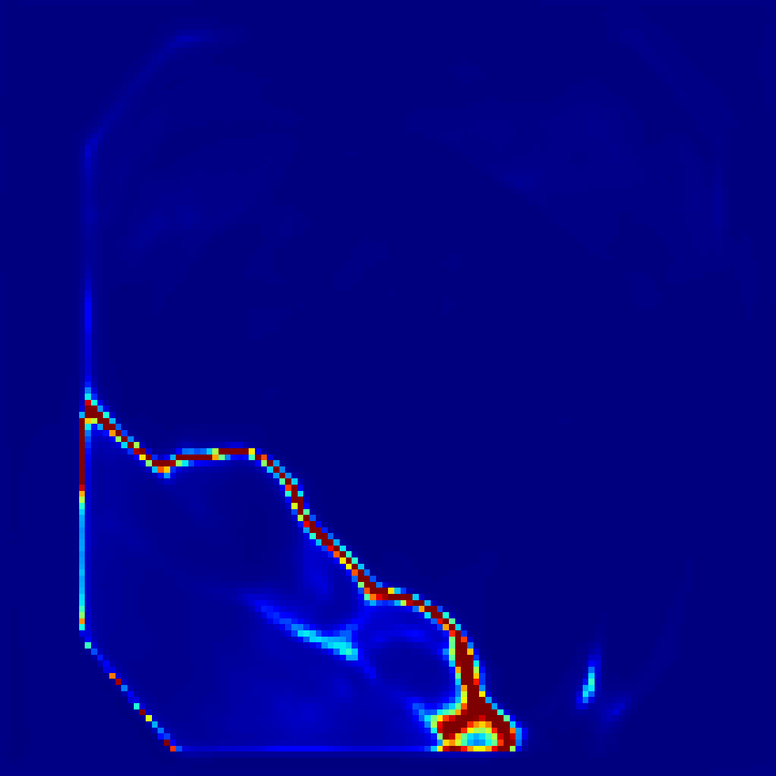
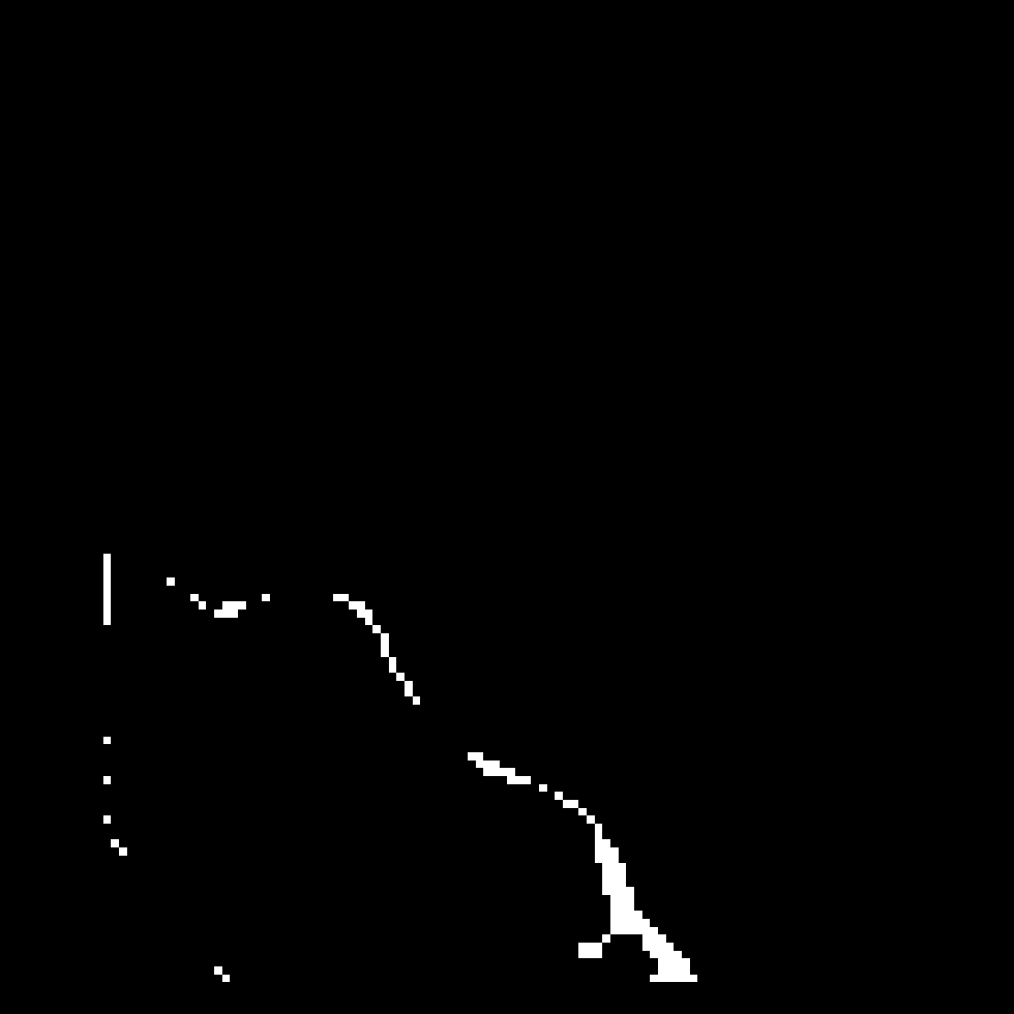


Input |  | PUGEUKAN | UKAN | EMCAD | SwinUNETR | AttentionUnet | Unet++ | UNet
 | Outputs
GT | Uncertainty Map
 | loss
 | Outputs
GT | Uncertainty Map
 | loss

Slide 3
Uncertainty Map
$$1×H×W$$
$$u=\frac{K}{S}$$
$$D\left(p | α\right)=\left\{\begin{aligned}\frac{1}{B\left(α,β\right)}p_{0}^{α−1}p_{1}^{β−1} \\ 0 else\end{aligned}\right.$$
$$3×H×W$$
$$C_{1}×\frac{H}{2}×\frac{W}{2}$$
$$C_{1}×\frac{H}{2}×\frac{W}{2}$$
2$×H×W$
UAB
$$C_{2}×\frac{H}{4}×\frac{W}{4}$$
$$C_{2}×\frac{H}{4}×\frac{W}{4}$$
Evidence
$$2×H×W$$
Segmentation results
$$1×H×W$$
$$C_{1}×\frac{H}{2}×\frac{W}{2}$$
$$C_{1}×\frac{H}{2}×\frac{W}{2}$$
$$C_{3}×\frac{H}{8}×\frac{W}{8}$$
$$C_{2}×\frac{H}{4}×\frac{W}{4}$$
$$C_{3}×\frac{H}{8}×\frac{W}{8}$$
Evidence head
Skip connection
$$D_{1}×\frac{H}{16}×\frac{W}{16}$$
$$D_{1}×\frac{H}{16}×\frac{W}{16}$$
$3×3$Conv
$$C_{3}×\frac{H}{8}×\frac{W}{8}$$
KAB
KAB
Micro Step& Dilated Conv Block
Addition
$$D_{2}×\frac{H}{32}×\frac{W}{32}$$
KAB
KAB
$$D_{2}×\frac{H}{32}×\frac{W}{32}$$
Up sampling

Slide 4
UAB:Uncertainty Attention Block
Q
Q Conv
Image
K
K Conv
MLP
Maxpool
1x1 Conv
V
feature
Uncertainty Map
V Conv
Softmax

Slide 5
MDB:Micro Step& Dilated Conv Block
Input
1x1 Conv
Maxpool
MSCB
MSCB
DC1
DC1
MSCB
DC2
$$×α$$
$$×(1−α)$$
Output

Slide 6
MSCB
3x3 Micro Step Conv
Maxpool
Batch Norm
DC1
3x3 Dilated Conv dilation=2
Batch Norm
DC2
3x3 Dilated Conv dilation=3
Batch Norm

